Slide 1
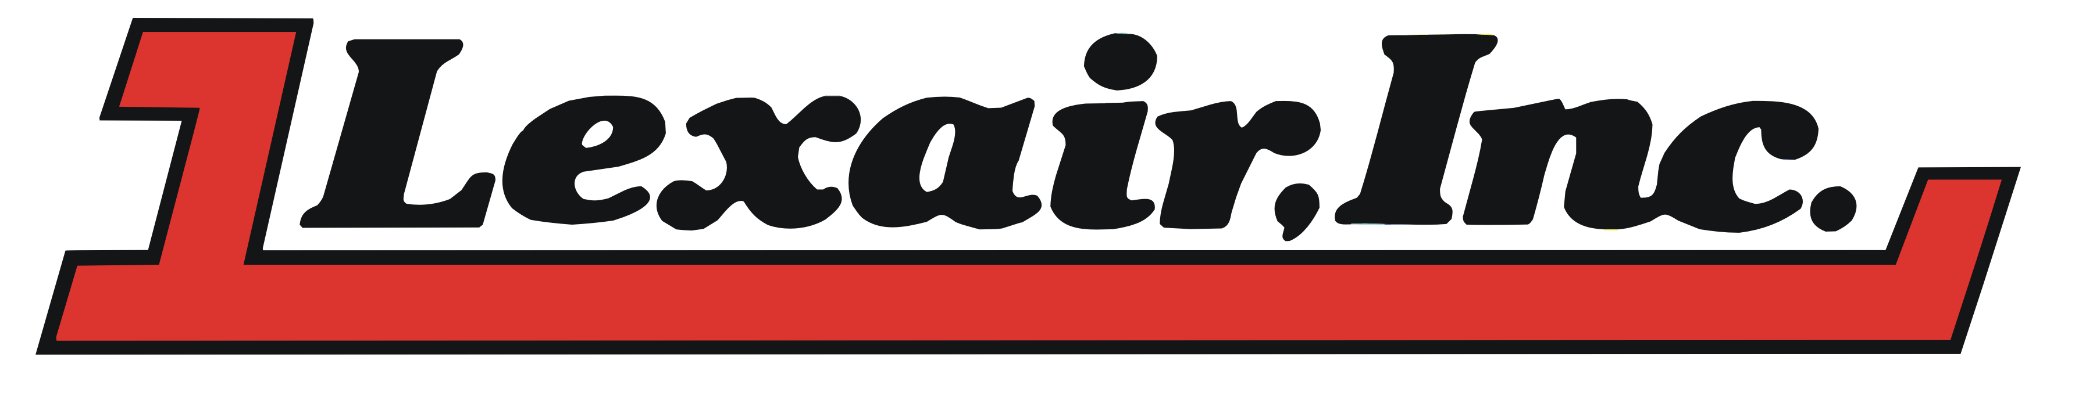
Ph: 859-255-5001
Fax: 859-255-6656
www.lexairinc.com

Slide 2
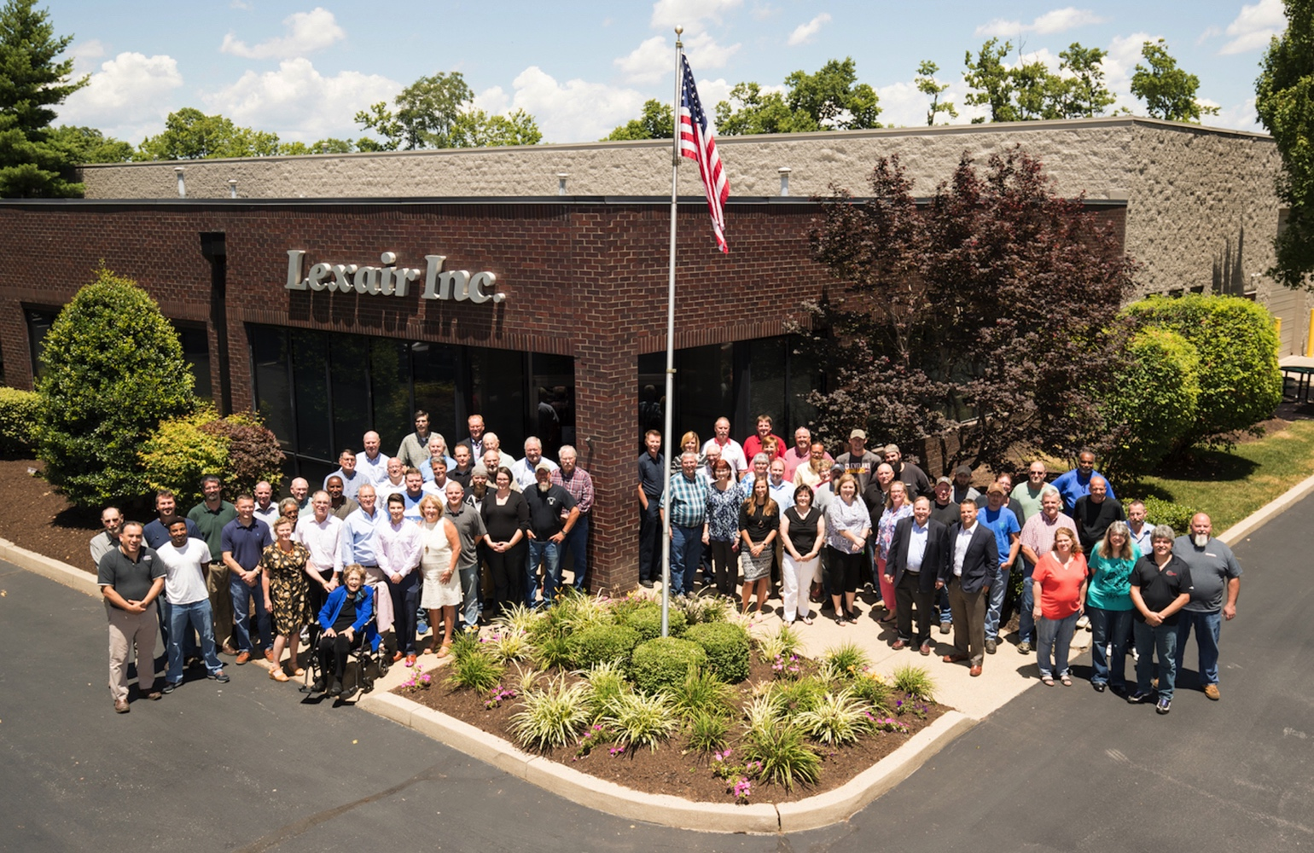
Lexair is a privately held, American owned corporation established in 1977 committed to the design and manufacturing of industrial products. We are a world class manufacturer of fluid power products, valves, and machine tool accessories.

Slide 3
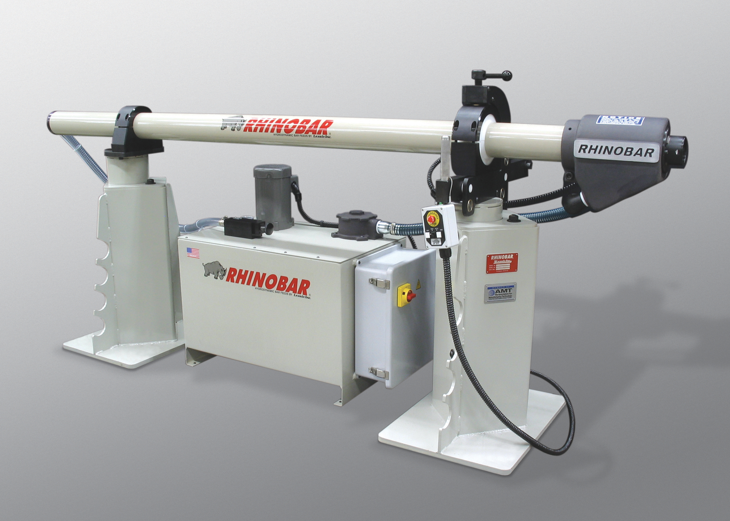
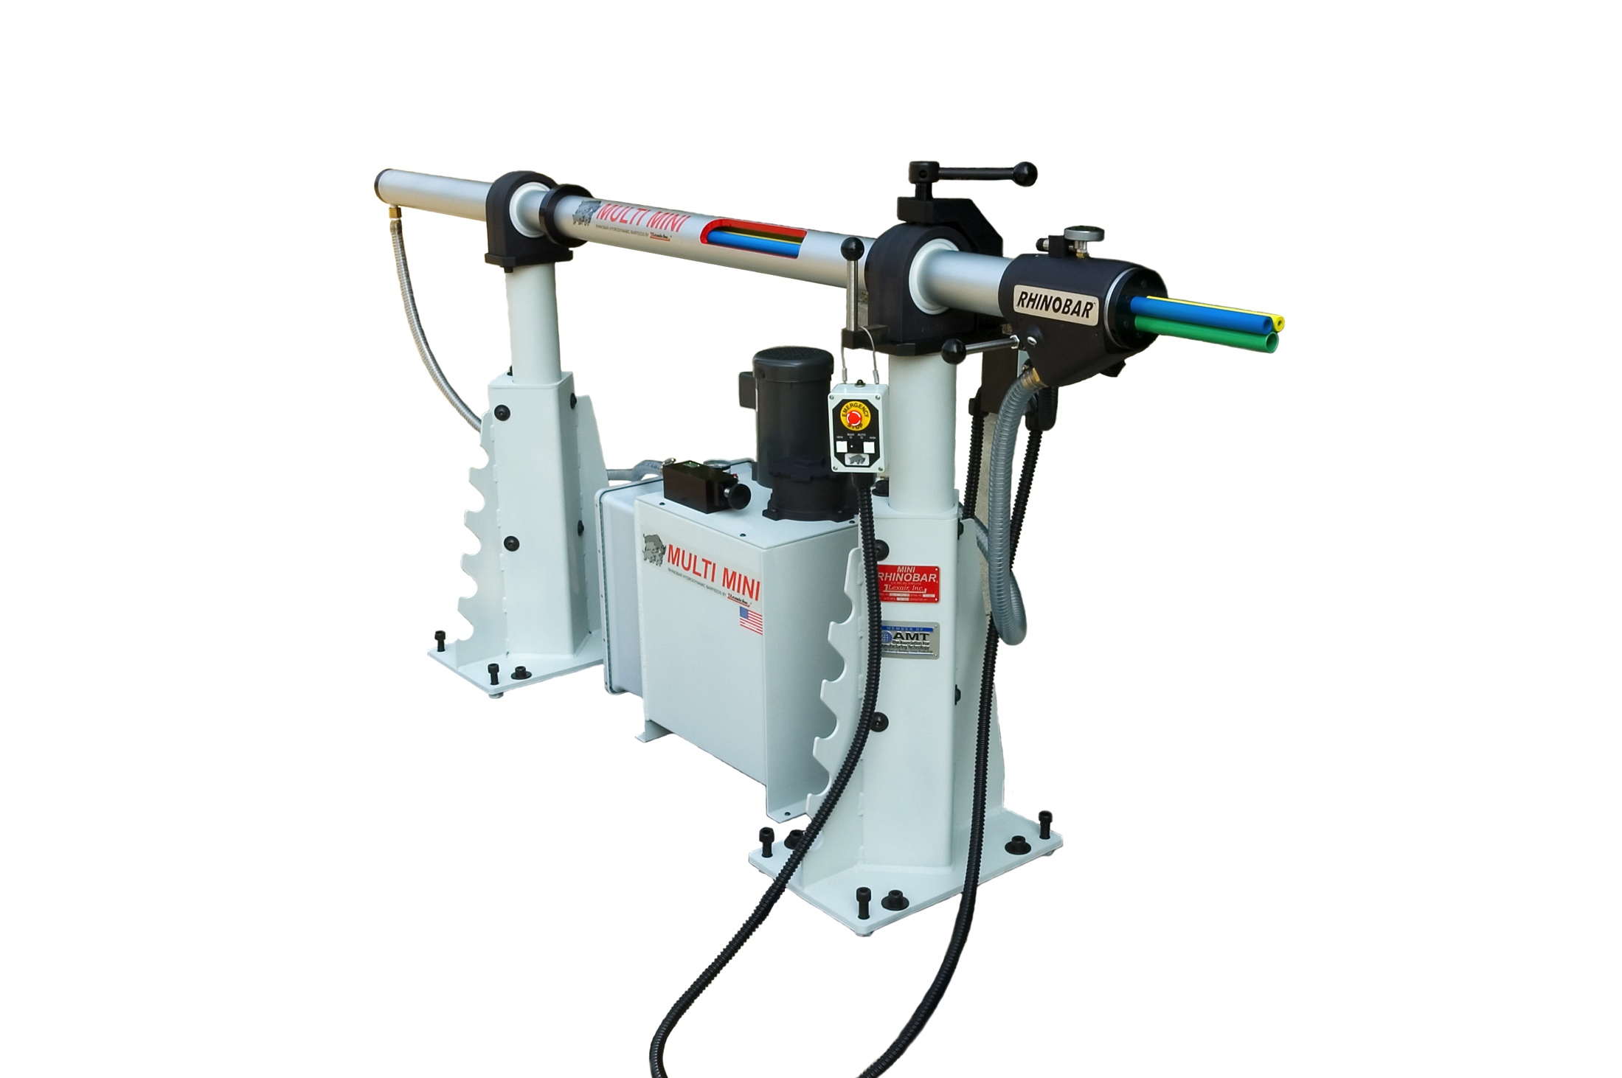
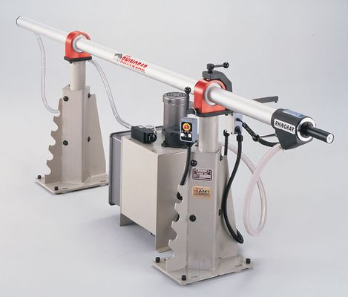
Machine Tool Accessories
Hydrodynamic Style Barfeed Systems
Multi Mini®
Mini Rhinobar®
Rhinobar®

Slide 4
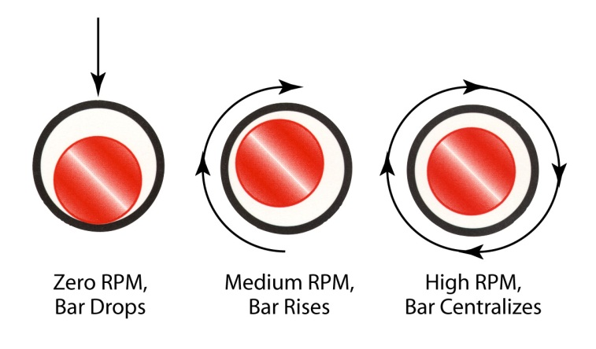
Rhinobar® Hydrodynamic Barfeed
Designed for use with all types of CNC lathes
Operates on the hydrodynamic principal to support the bar stock
Single tube barfeed
Lexair valve to control pressure and flow
Bearing mounted pusher cone
Mobile pendant to control barfeed
Automatic pusher return at end of bar signal
Support bushings mounted to face of oil recuperator

Slide 5
Rhinobar®
Designed for use with all types of CNC lathes
RB 2.5 diameter range ¼” to 2 1/2”
RB 3.0 diameter range ½” to 3”
Feed tubes come in ¼ increments
12 ft. max barstock length
Overall Length 18 ft.
Supplied with your choice of 3 feed tubes

Slide 6
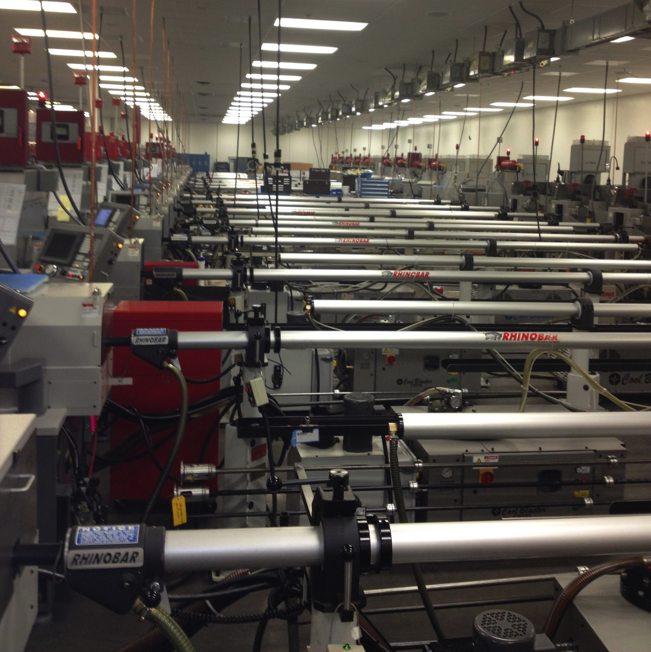
Mini Rhinobar
Engineered for swiss-style and small headstock CNC lathes
Feed tube size from 1/8”to 1 5/8”
1/8 inch increments in feed tubes
Capable of feeding wire gauge material
Max 12 ft. barstock
Overall 17ft
Supplied with your choice of 3 feed tubes

Slide 7
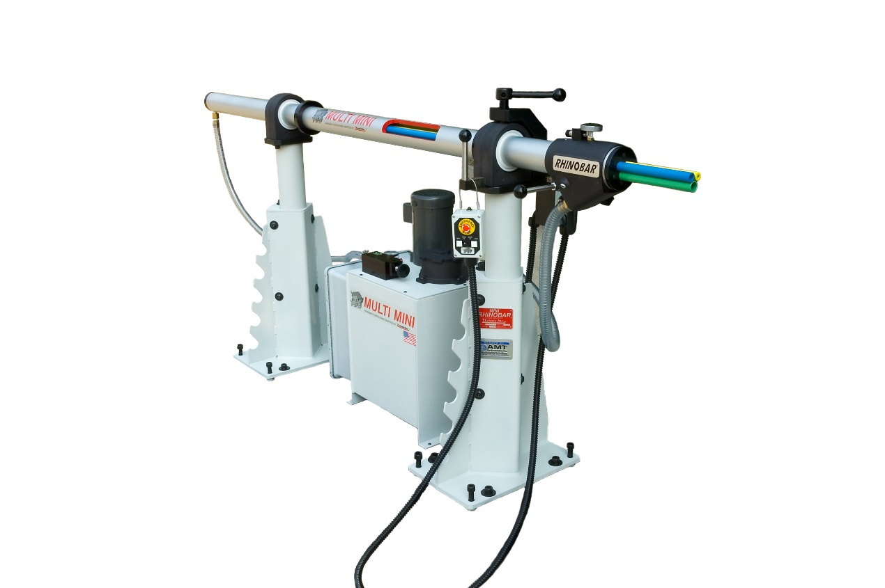
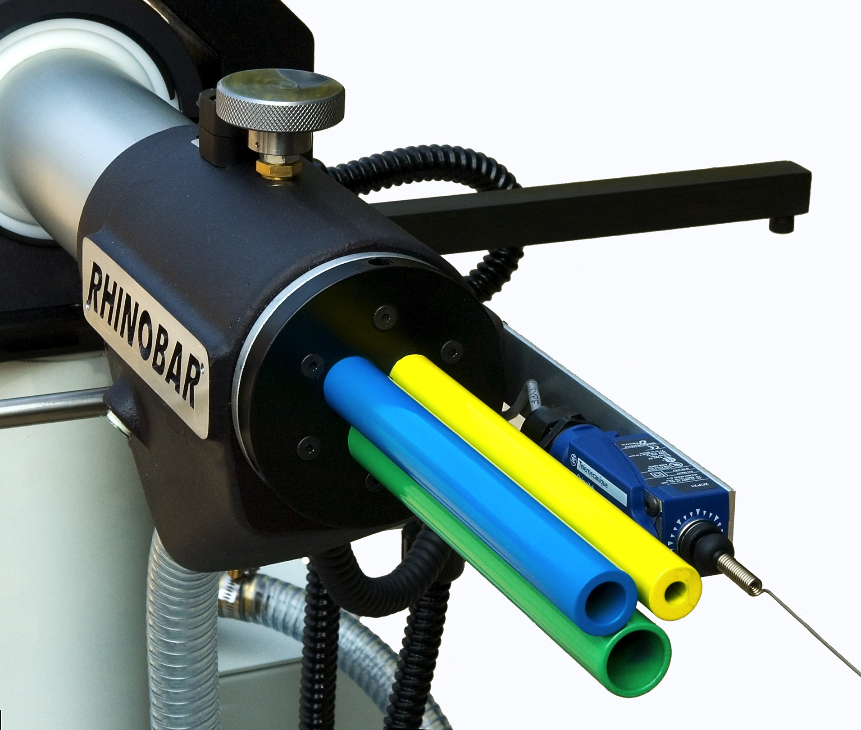
Multi Mini Rhinobar
Indexable cartridge
Standard cartridges
  1/4” 3/8” 1/2”
  1/4” 1/2” 3/4”
  3/8” 3/8” 5/8”
Three tube gatlin gun style bar feed designed for Swiss machines
1 to 20 mm capacity

Slide 8
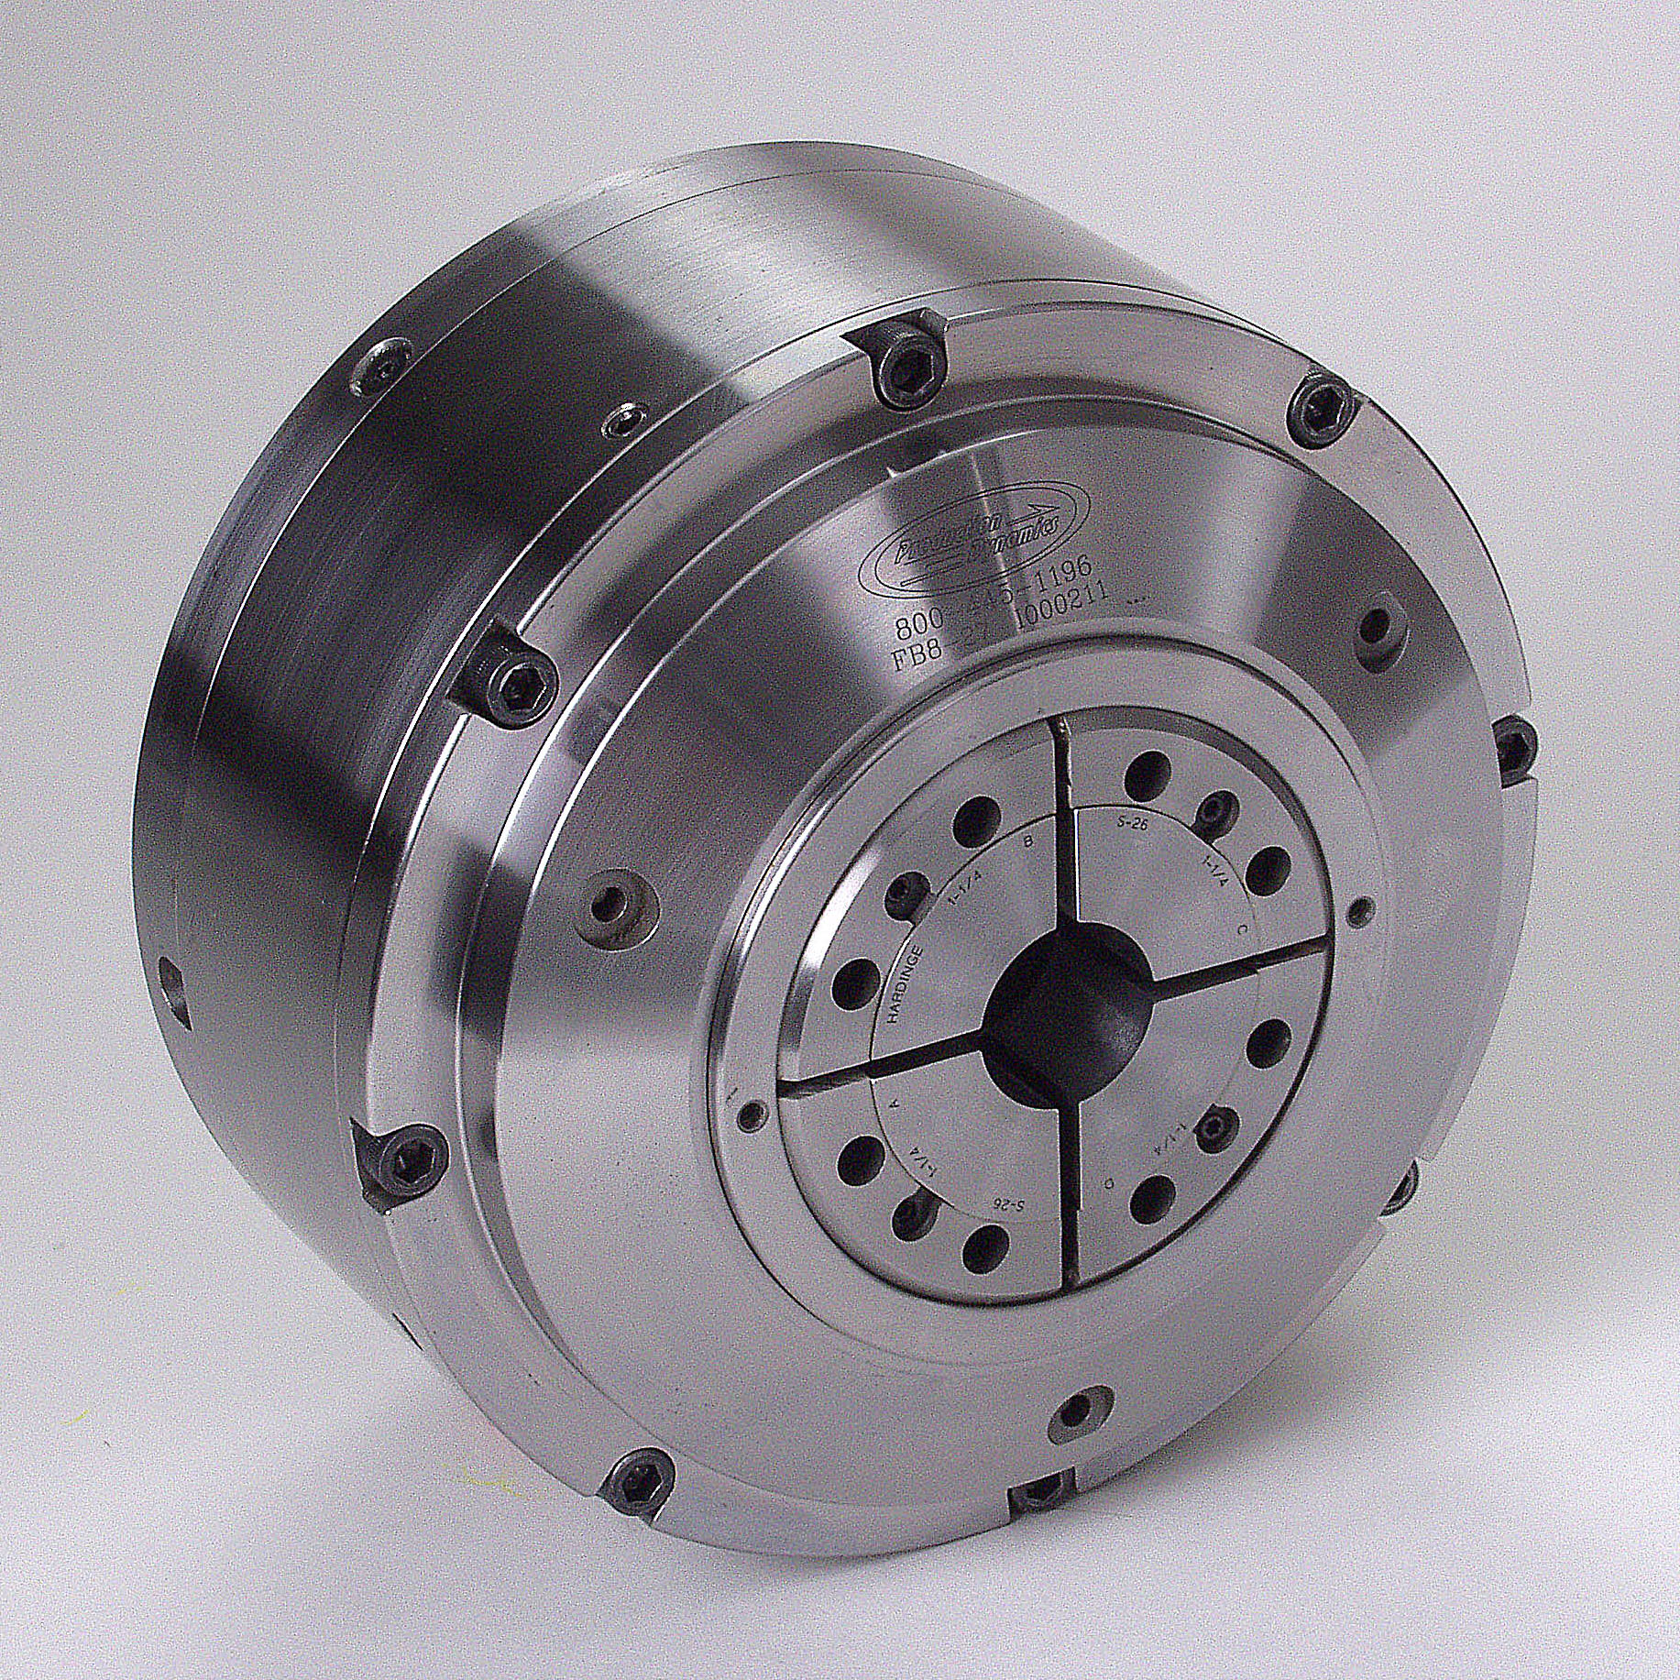
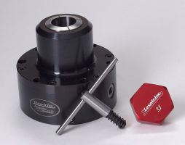
Collet Chucks
Lexair offers precision collet chucks ranging from self-contained mechanical grip/air released fixed-length versions to pull-back drawtube actuated models and wrench operated units for applications where no drawtube is available. Our chucks can accommodate parts up to 5-1/2 inches in diameter.
Wrench Operated
Full Bore®

Slide 9
Die Springs
Faceplate
Fixed Length collet chuck
Fully self contained
Spring clamp, Air unclamp
Constant grip force at all RPMs
Suitable for main and sub Spindle
Direct mount
Includes Master collet
  Uses S style pads
Types of material
  Thin wall tubing
  Solid bar stock
  Hex bar stock
  Square bar stock
Ramp
Pusher
Roller Assembly
Collet
Piston
Gland
Grip Force
Indicator
Gland Housing
Concentricity adjustment
Full Bore® Chuck
Notes:
The FULL BORE® Chuck is a self contained, mechanical grip, air release front-mounted collet chuck. The chuck does not require an external actuator. Air is used only to OPEN the chuck. Spring force holds the work piece while it is being machined. Thus, the part remains clamped, even if air pressure is lost. Higher spindle speeds are available since a collet chuck does not have heavy jaws that lose grip force as the spindle speed of the machine increases. Clamping force is adjustable by tightening or loosening the collet using the spanner holes in the front of the collet. The clamp force can also be reduced by removing pairs of springs inside the chuck. The chuck does not require a draw tube, making more spindle area available.
The gland and gland housing are used to transmit the air to the chuck. When the spindle is stopped, and the chuck is opened, a valve admits air into the gland housing pushing the gland forward against the back of the chuck. The face of the gland seals against the chuck body and allows air pressure to build inside the chuck, forcing the piston forward. The rollers drop back, allowing the pusher to move back and release the collet. When the chuck is closed, the air in the gland housing is vented to the atmosphere, the gland retracts for the chuck body, and the springs and wedging action of the piston, ramp, rollers, and pusher close the collet on the part.

Slide 10
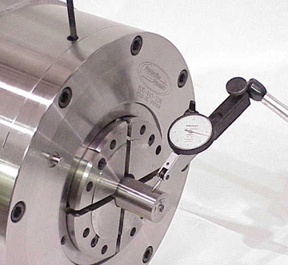
Eliminates the need for draw tube to increase your spindle and sub spindle thru diameter up to 35%
  Shorter body for tool clearance issues
    Standard concentricity adjustments
Full bore chuck
Standard 3 jaw chuck
Notes:
-Since the full Bore chuck is self contained, there is no need for the draw tube. By eliminating the draw tube you are able to increase the diameter of bar stock you can run on either your main spindle or sub spindle.
The overall profile of the the Full Bore is typically smaller than 3 jaw chucks which can help in tool clearance issues
Standard concentricity adjustment for high precision parts, have the ability to dial in the concentricity on the chuck in 4 different set screws spaces 90 degrees around the diameter.
The bottom image
Shows a traditional 3 jaw chuck with the spindle liner in red
Top image has the full bore attached and now you have 25-30% larger capacity to feed through the main spindle or sub spindle.

Slide 11
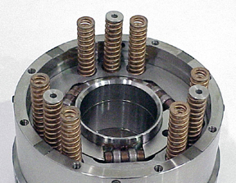
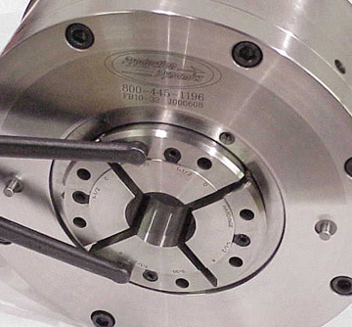
Adjustable clamp force
  Spanner wrench
  Removing or changing internal die springs
Spring close air open for fail safe operation
Clamp and unclamp operation in less than one second, suitable for high volume applications
No loss in clamp pressure due to centrifugal force
Notes:
- You can adjust the clamping force of the chuck b

Slide 12
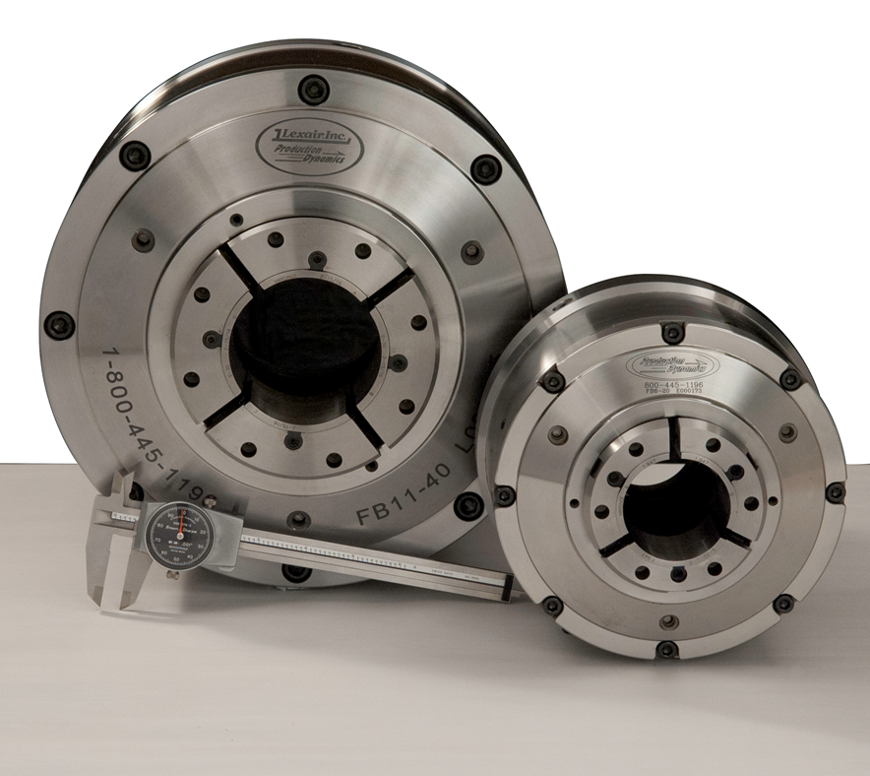
Model Number | Chuck Diameter | Master Collet (Pad Style) | Capacity Using Pads | Capacity Using Solid Collets | ASA Spindle | Weight (LBS) | Grip Force (LBF)
FB6-20 | 6.75 | S20 | 1/4 to 2 | 1/4 to 2 | A2-5 | 35 | 15,000
FB6-20 B60 | 6.75 | S20 | 1/4 to 2 | 1/4 to 2-3/8 | A2-5 | 35 | 15,000
FB8-27 | 8 | S26 | 1/4 to 2-5/8 | 1/4 to 2-3/4 | A2-6 | 49 | 17,000
FB10-32A | 10 | S30 | 1/4 to 3 | 1/4 to 3-1/4 | A2-6 | 85 | 20,000
FB10-32B | 10 | S30 | 1/4 to 3 | 1/4 to 3-1/4 | A2-8 | 85 | 20,000
FB11-40 | 11 | S35 | 1/4 to 3-1/2 | 1/4 to 4 | A2-8 | 130 | 30,000
FB14-55 | 14 | S50 | 1 to 5 | 1 to 5-1/2 | A2-11 | 235 | 35,000
* Adaptor plates can be made for a different Spindle nose

Slide 13
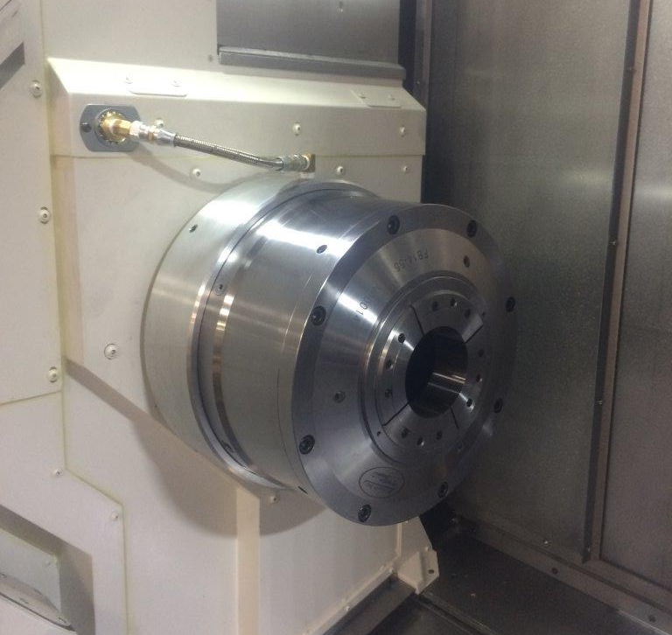
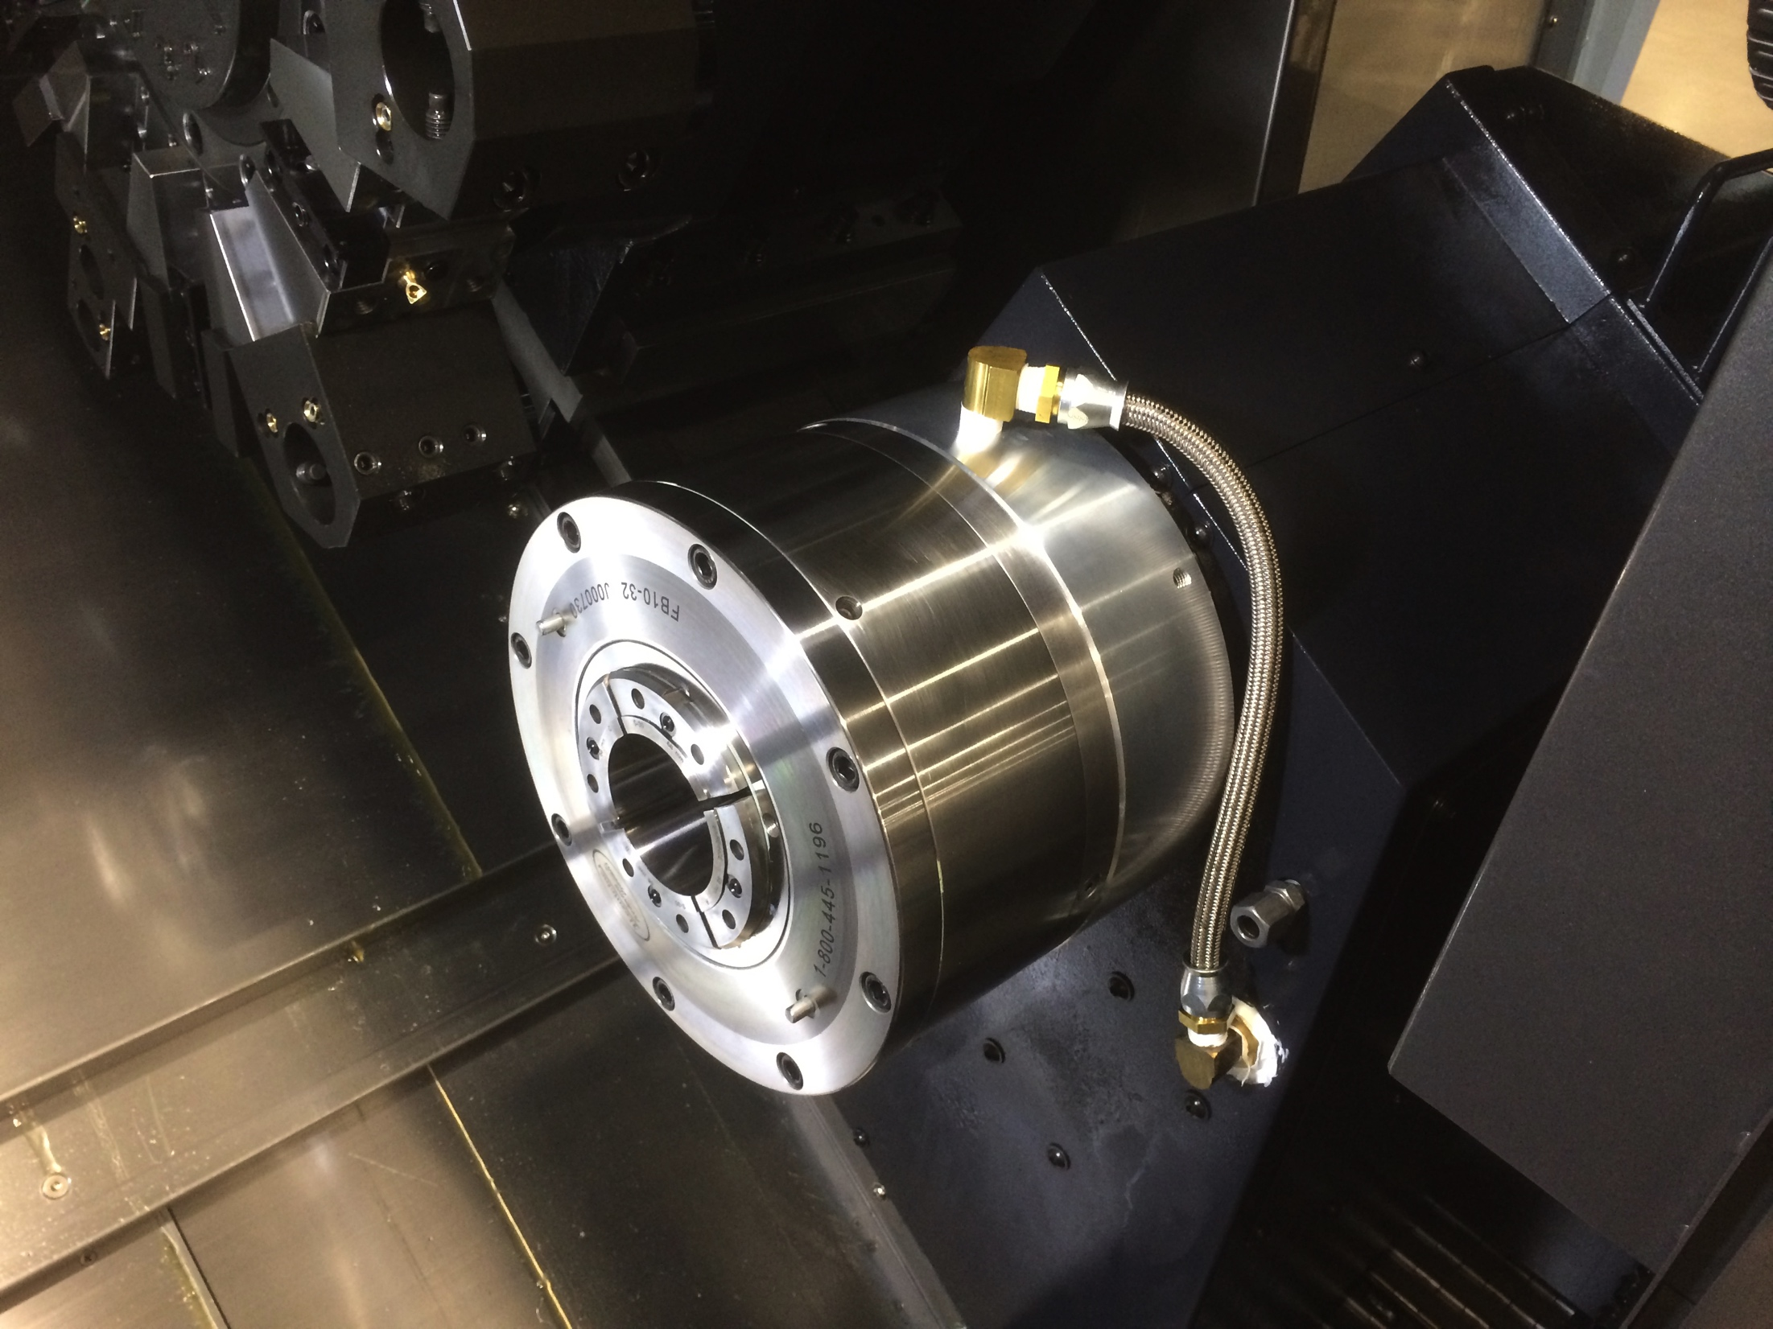
Main Spindle
Sub Spindle
Full Bore Applications

Slide 14
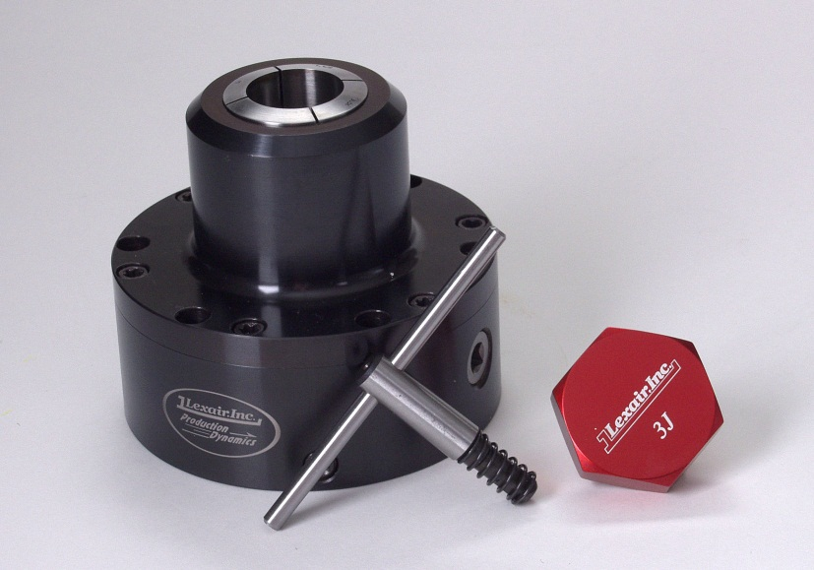
Wrench Operated Collet Chuck
Features manual actuation via a standard chuck key – no drawtube or closer is required
Incorporates a flat back design which can easily be used in any application on lathes, mills, grinders, etc for all your machining needs
Can be directly bolted to the table for applications involving mills, machining centers or drill presses
Lathes, indexers and other rotating spindle equipment will require an adapter plate which we can provide from an extensive line covering a broad range of brands and types
Concentricity adjustment is standard – allows the operator to obtain the best possible part accuracy
Ideal for use on the new hybrid CNC/manual lathes
Accepts 5C, 16C, 3J and 22J collets

Slide 15
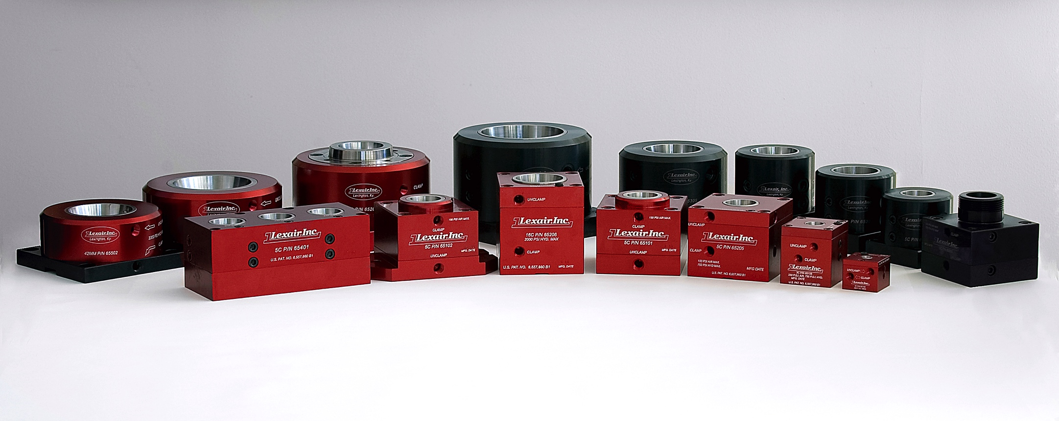
Collet Closers
Complete family of stationary collet workholding components that can be utilized individually or grouped together to form a system
Double acting pneumatic or hydraulic models are available in fixed-length and pull-back versions

Slide 16
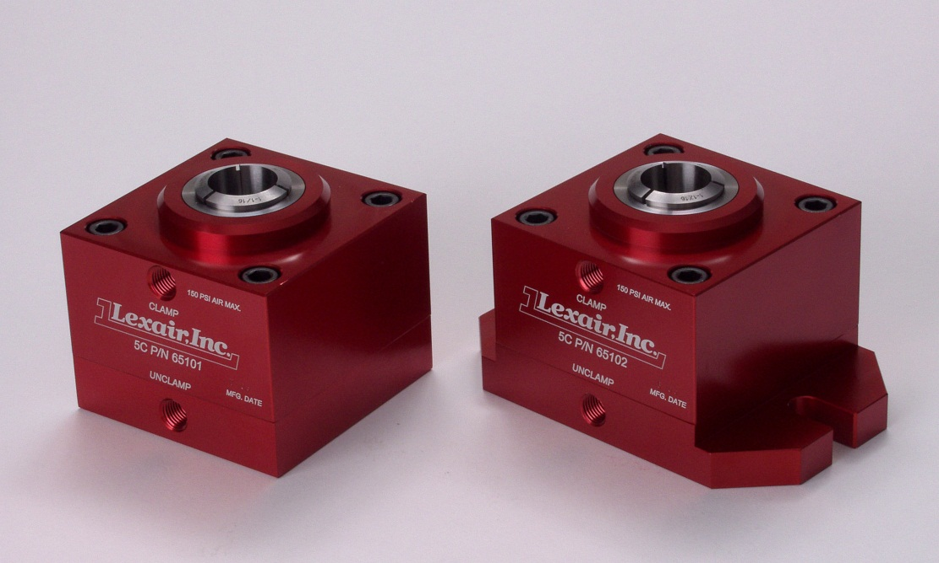
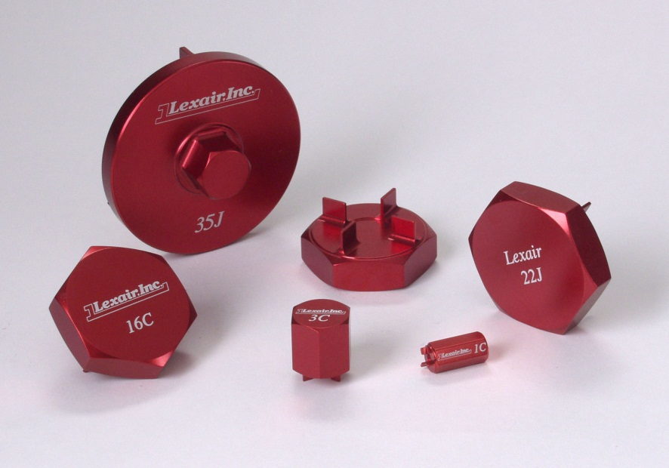
Low Pressure Pneumatic Collet Closers
Double acting, pull-back operation
Designed for use with 5C collets
Drawtube force generated is 7.5 times the inlet pressure applied
Maximum working pressure is 150 PSI
Supplied with a 5C collet wrench

Slide 17
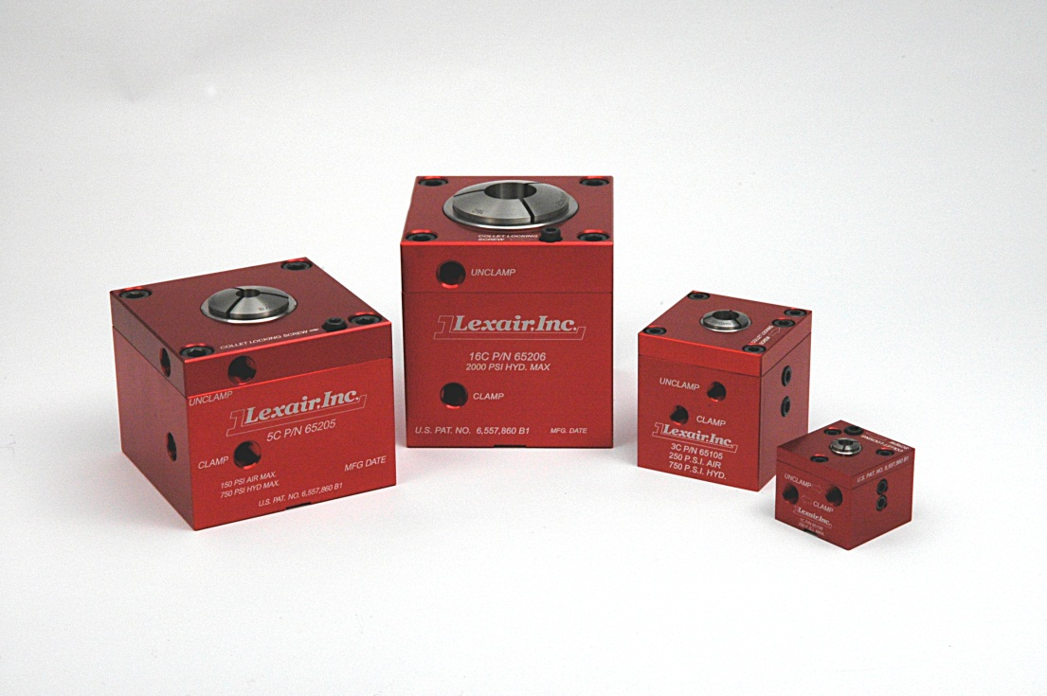
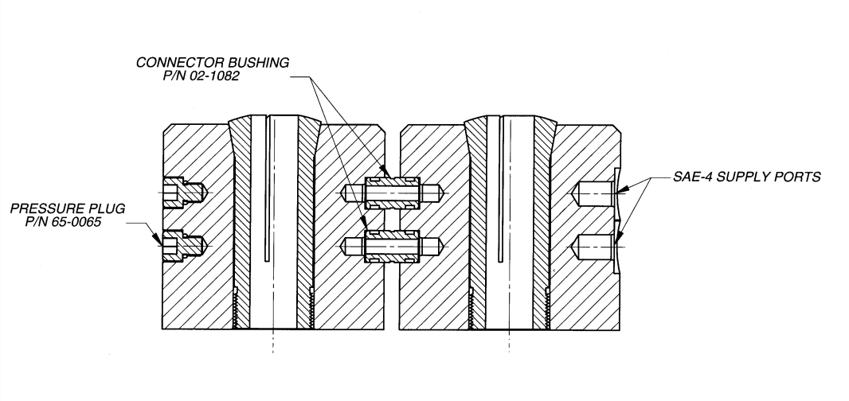
Pneumatic/Low Pressure Hydraulic Collet Closers
Double acting, fixed-length operation
1C, 3C, 5C or 16C collets
Patented “Top Lock” collet locking screw
Ability to connect multiple closers via bushings
Drawtube force generated ranges from 0.7 (1C) to 7.5 (5C) times the inlet pressure applied
Through hole design for long parts

Slide 18
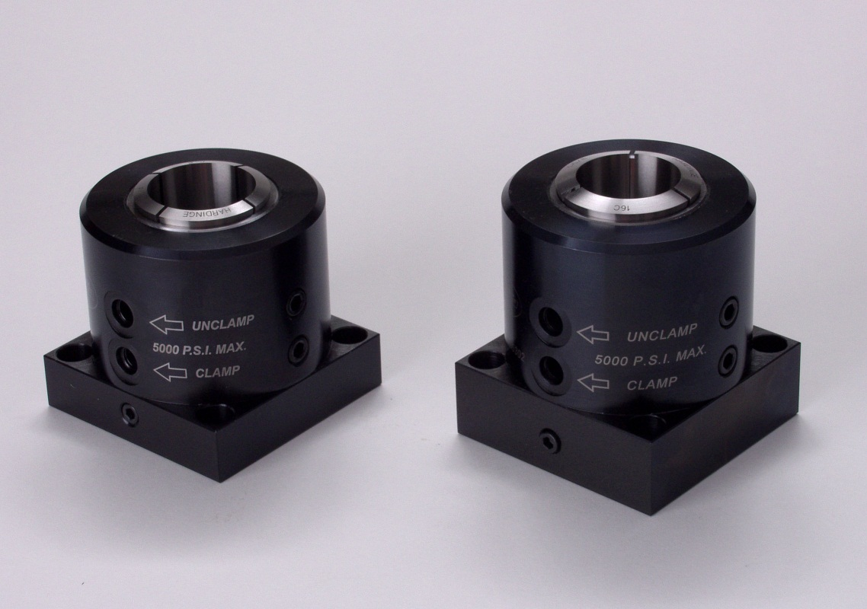
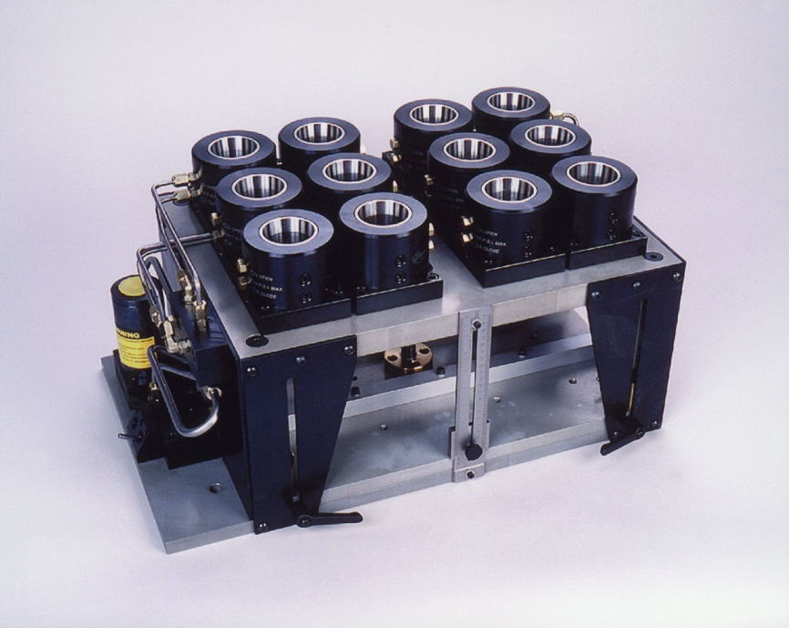
High Pressure Hydraulic Collet Closers
Double acting, fixed-length operation
5C, 16C, 3J, 22J or 35J collets
All steel construction
Drawtube force is 1.9 times line pressure
Ability to connect multiple closers via bushings
Hydraulic pressure up to 5000 PSI

Slide 19
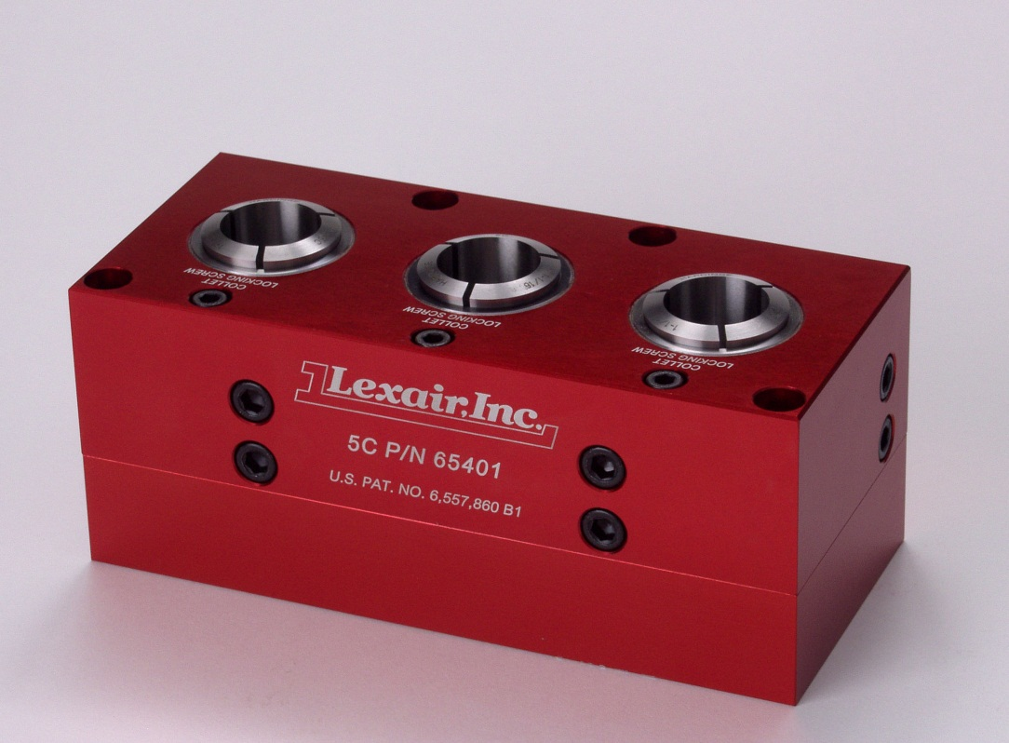
High Pressure Hydraulic Tri-Grip Collet Closers
Double acting, fixed-length operation
Compact design features three 5C collet closers in one body
Ability to be combined into multiple configurations by use of connector bushings – eliminates the external plumbing between units
Patented “accessible-from-the-top” collet locking screw – allows quick and easy collet or part orientation in infinite positions
Drawtube force generated is 1.1 times the inlet pressure applied
Hydraulic working pressure to 2800 PSI
All units are supplied with a matching 5C collet wrench

Slide 20
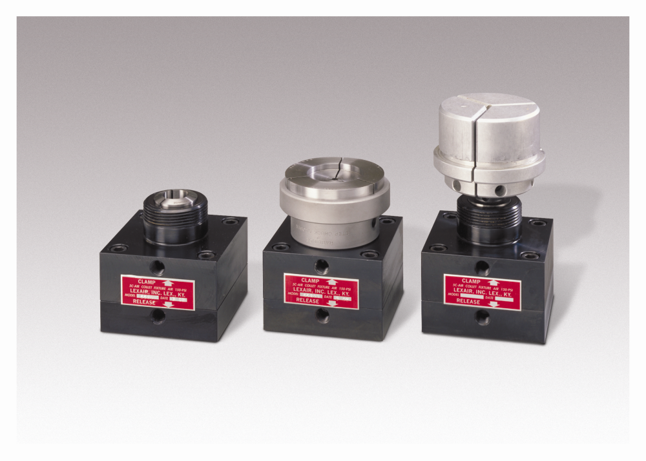
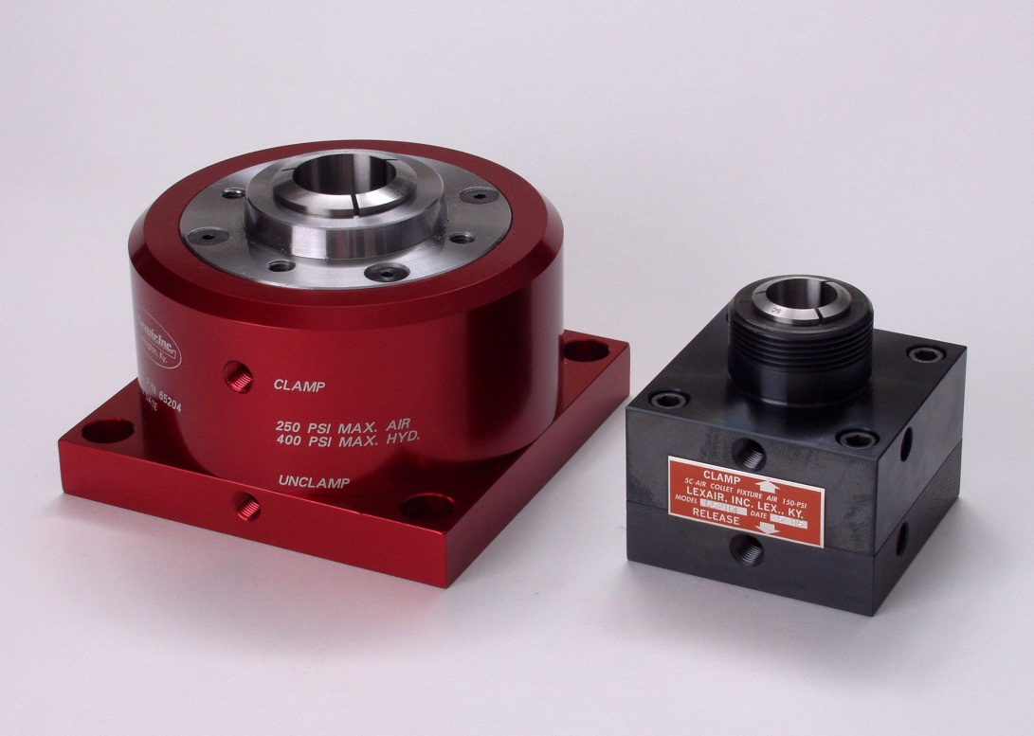
Pneumatic/Hydraulic Step Chuck Collet Closers
16C and 5C Step Collet
5C Details
Double acting, pull-back operation
All steel construction
Holds standard collets
Step chucks and closers
Expanding collets for I.D. holding of parts up to 6” in diameter

Slide 21

Collet Wrenches
Complete line of high quality, light-weight, aluminum collet wrenches
Anodized red with our logo and collet size laser engraved – assures that markings will not wear off
Available in sizes that fit our wide range of collet closers – including 1C, 3C, 5C, 16C, 3J, 22J and 35J sizes
One of our durable units is supplied in the correct size with any collet closer that we manufacture

Slide 22
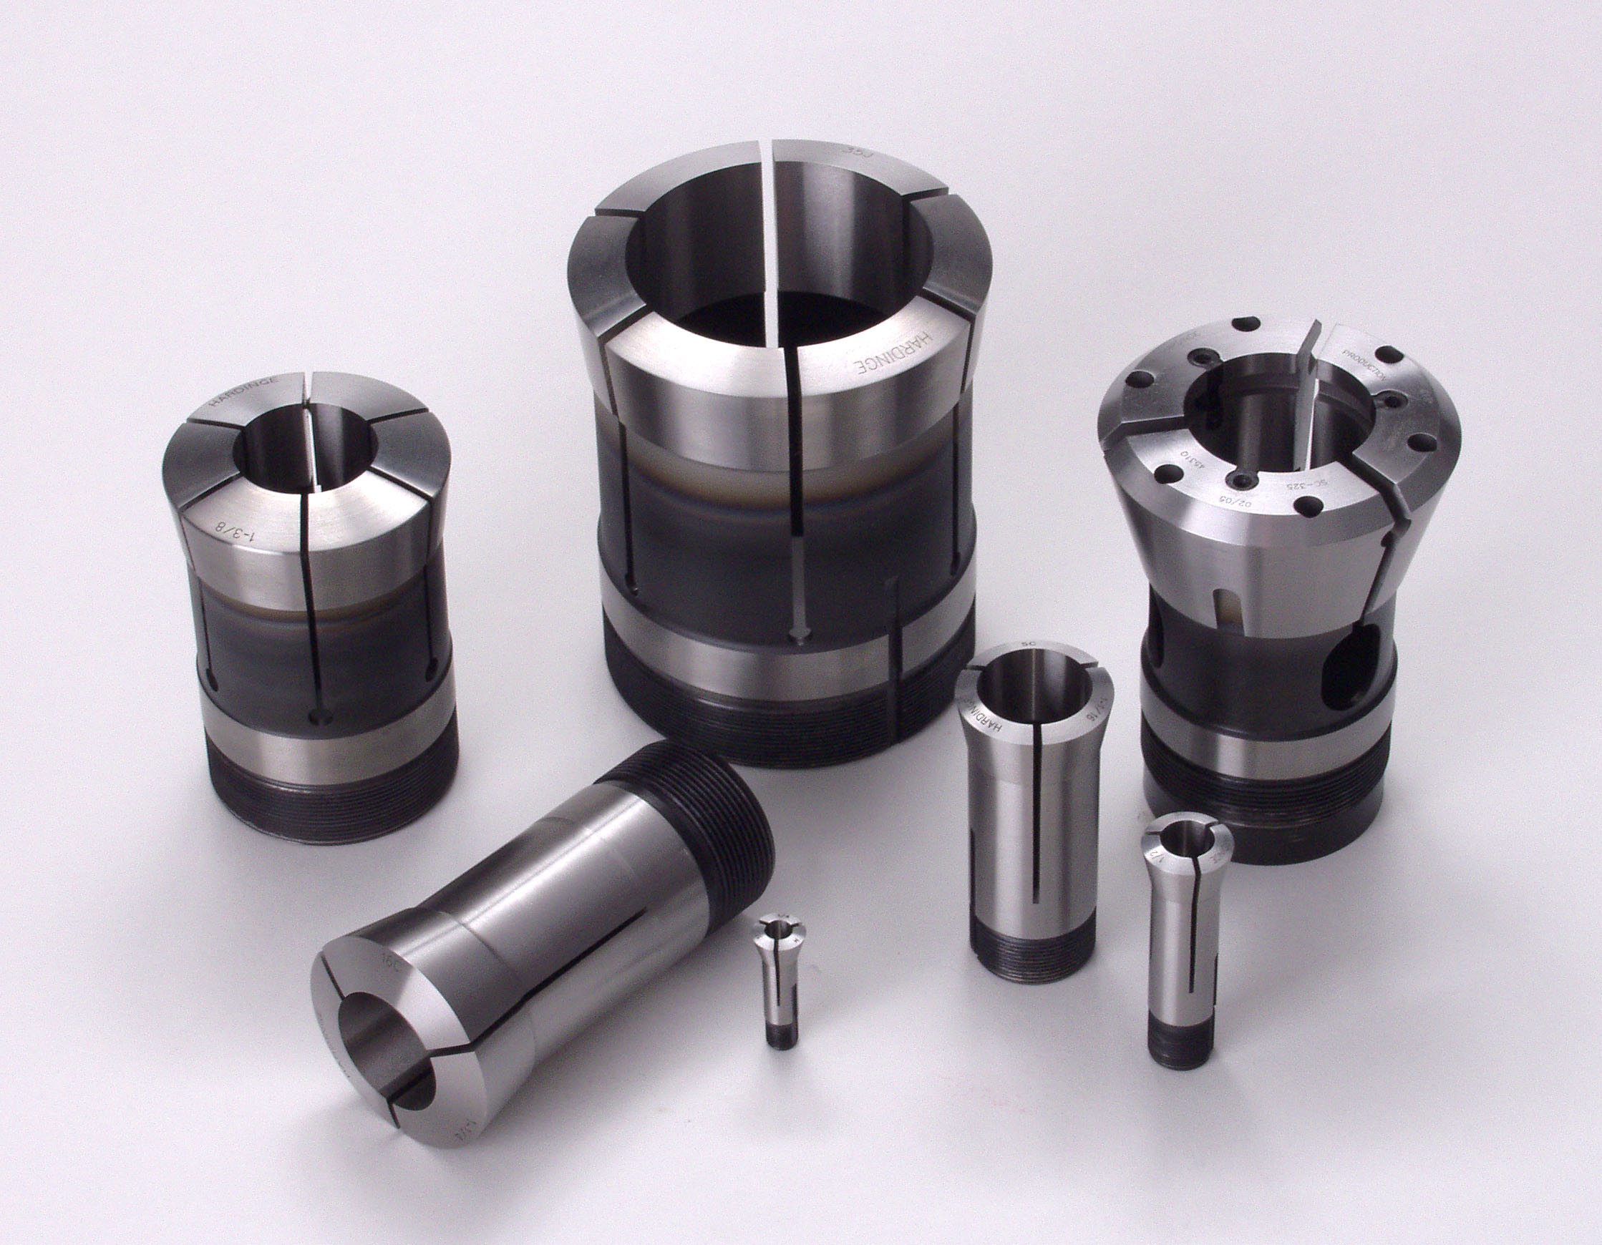
Collets
Lexair offers a complete line of collets available in all sizes and types to fit our entire line of collet closers and chucks. Please consult the factory for assistance and further information for all your collet applications.

Slide 23
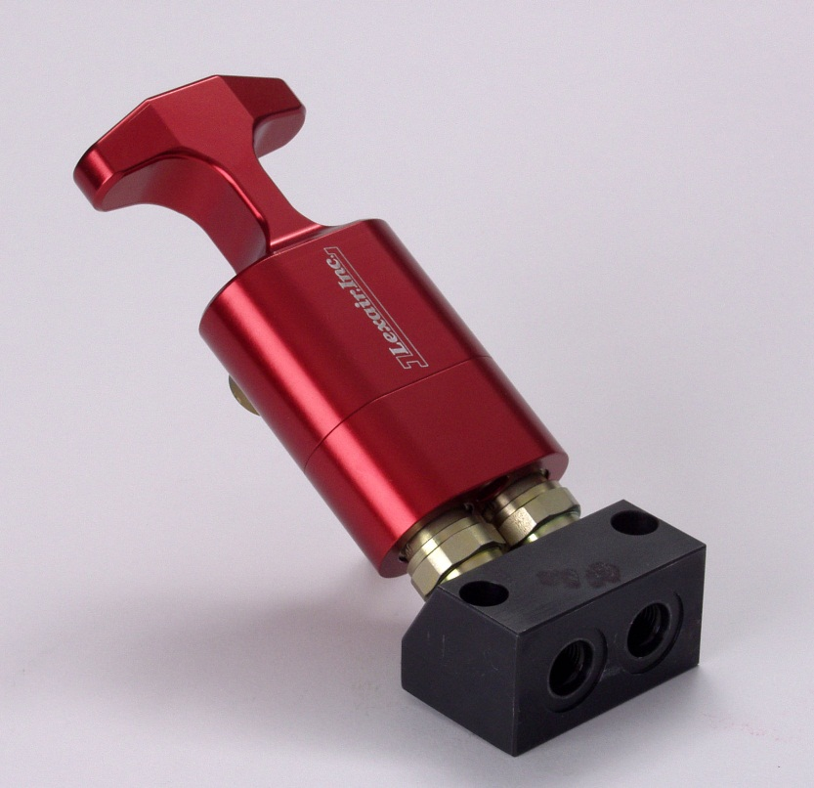
Disconnect Handles
Patented disconnect handle quickly and conveniently allows for connection/disconnection of hydraulic lines to/from machine tool pallets or in other hydraulic applications
Designed for use in double acting applications
The unit automatically latches when pressure above 2500 PSI is present on either hose preventing accidental disconnects
Ergonomic design helps minimize operator hand fatigue
Can be integrated with all Lexair hydraulic collet closers
To be used in conjunction with a matching Lexair manifold. If used with the manifold that features the integrated check valve, a momentary hydraulic pump or a 4-way, 3-position, exhaust open center valve must be used – please contact the factory to get the correct plumbing arrangement for your application

Slide 24
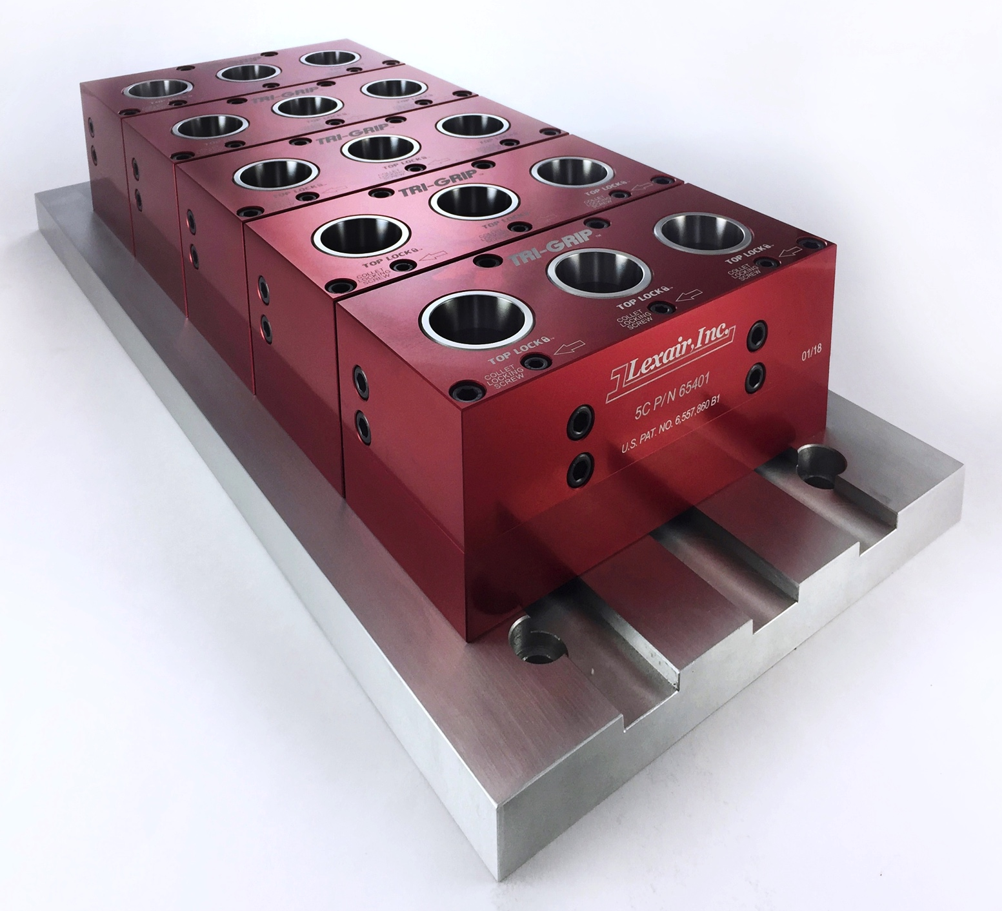
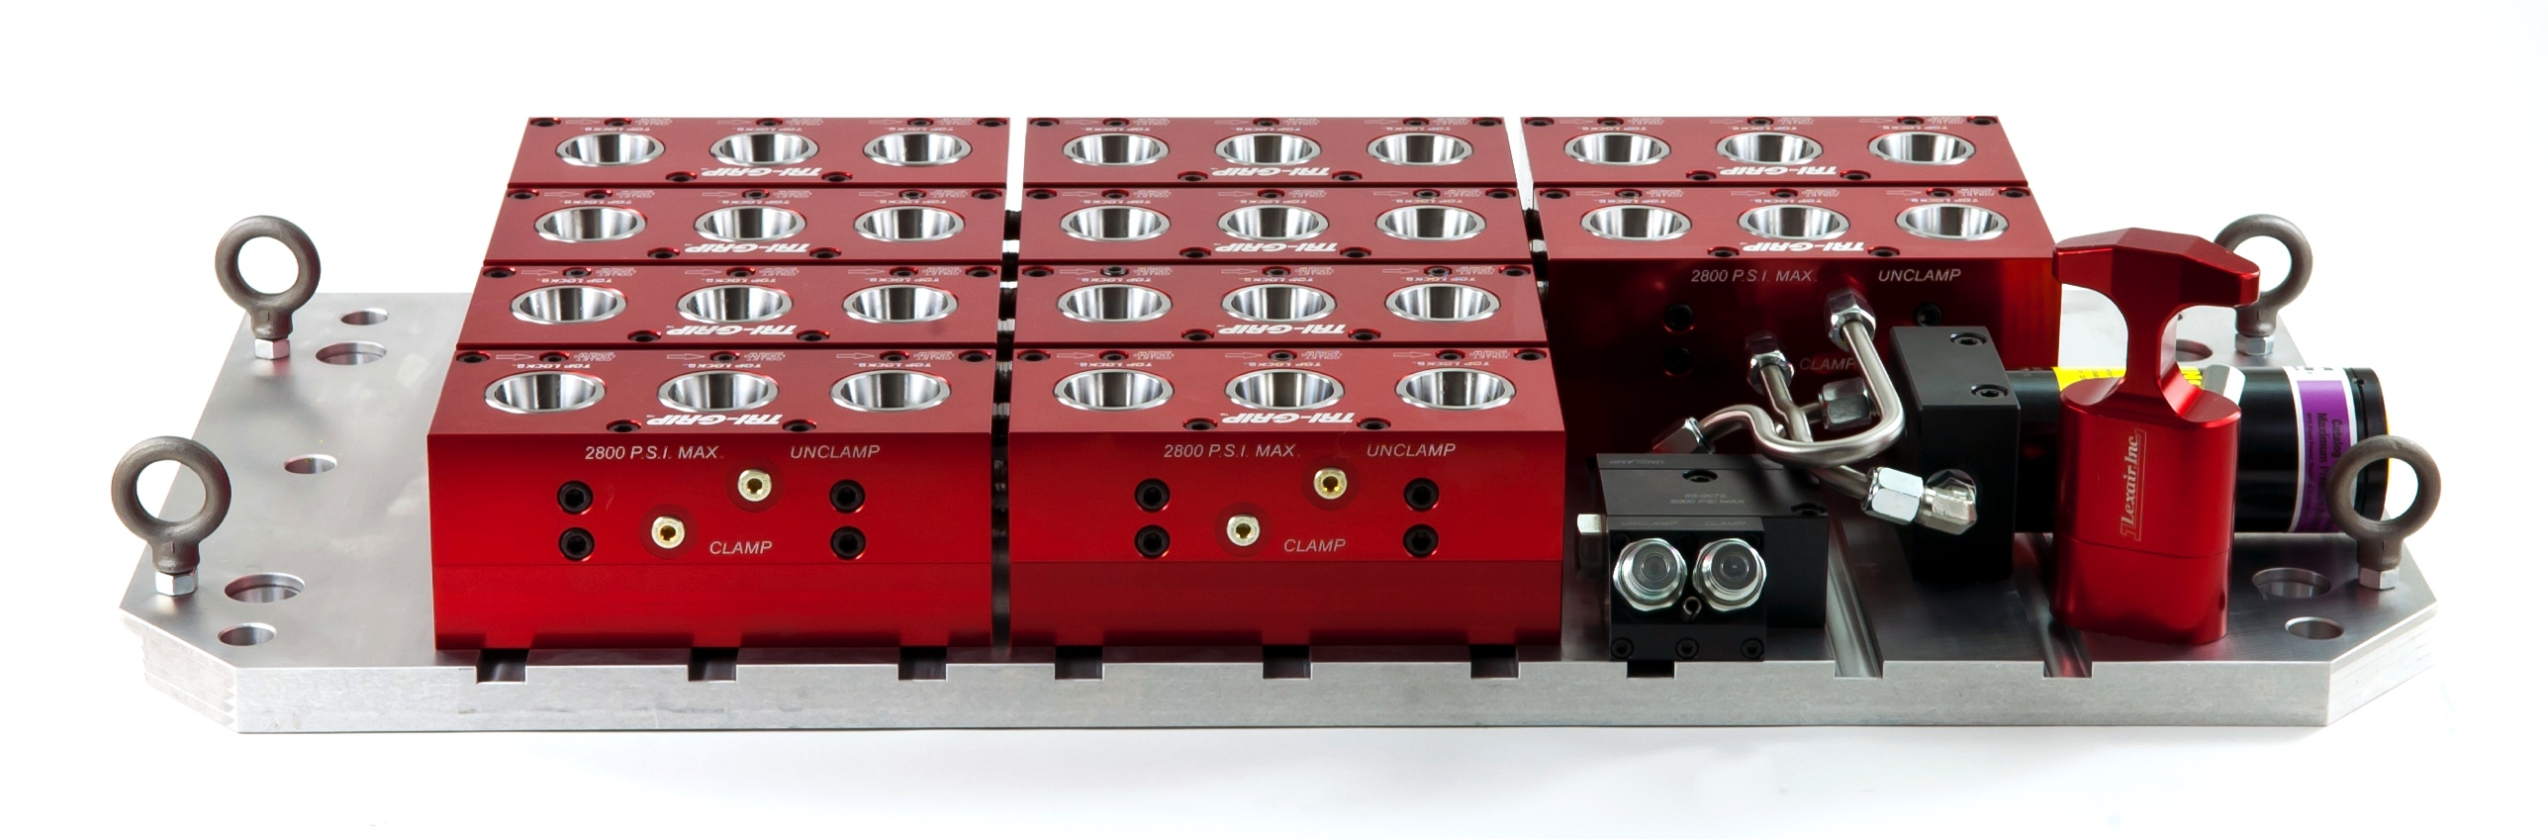
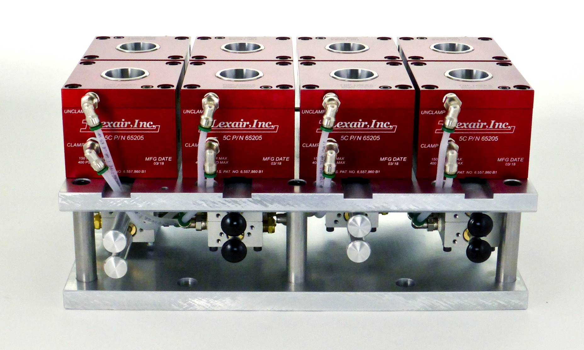
Custom fixture Plates
Complete custom solution for your workholding application
Pneumatic or hydraulic actuation
In house design and engineering team
Standard aluminum fixture plate
Steel plates can be use in heavy duty applications

Slide 25
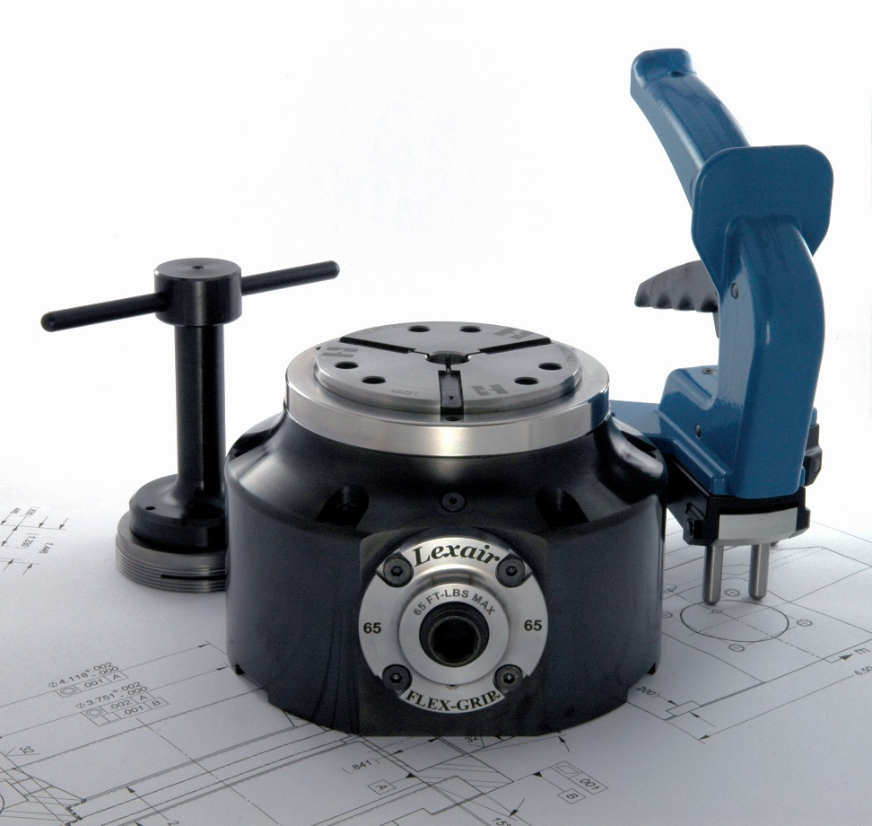
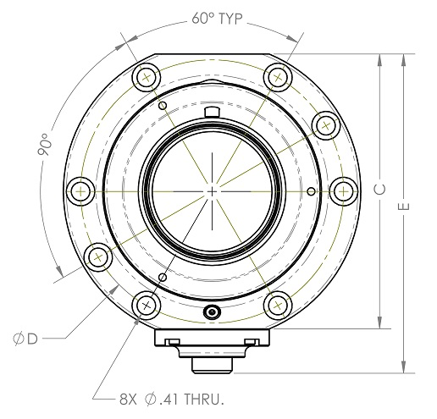
Flex Grip collet closer
65 & 80 mm capacity
Manual or hydraulic actuation.
Can mount on machine table or rotary table
Adjustable part stop

Slide 26
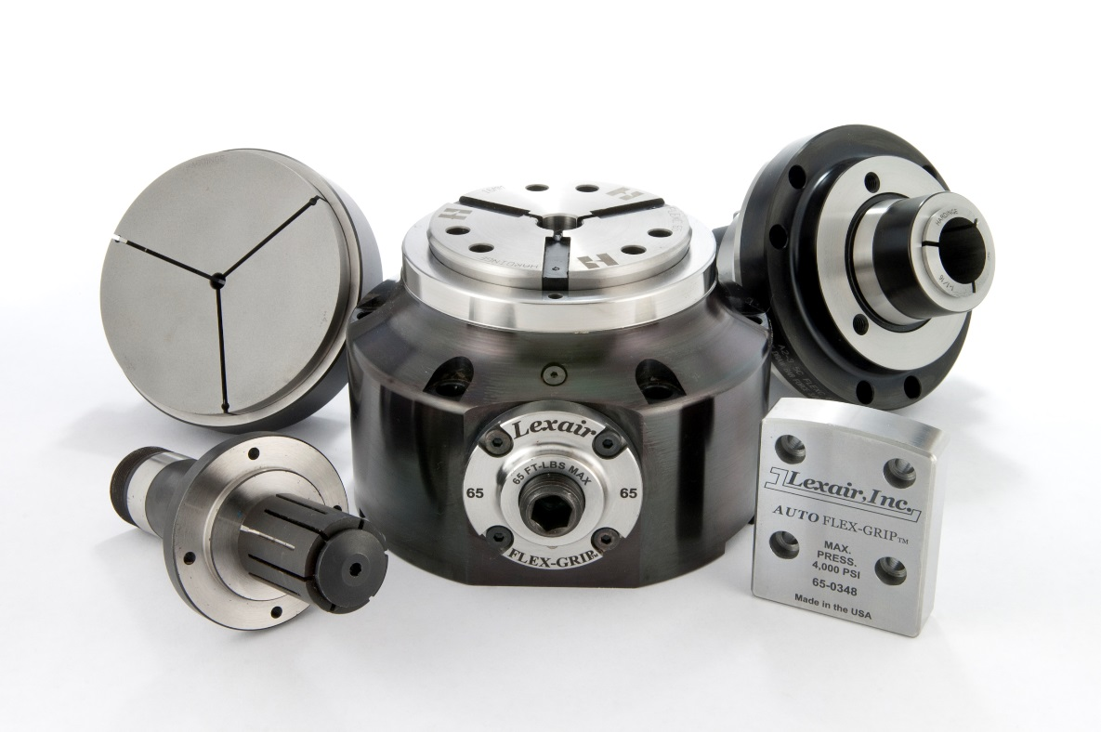
Additional clamping configurations
Flex C collet for quick change capability
  +/- 0.020 range
5c and 16c collet
Step chuck to 7in capacity
ID mandrel
Hydraulic clamp capable

Slide 27
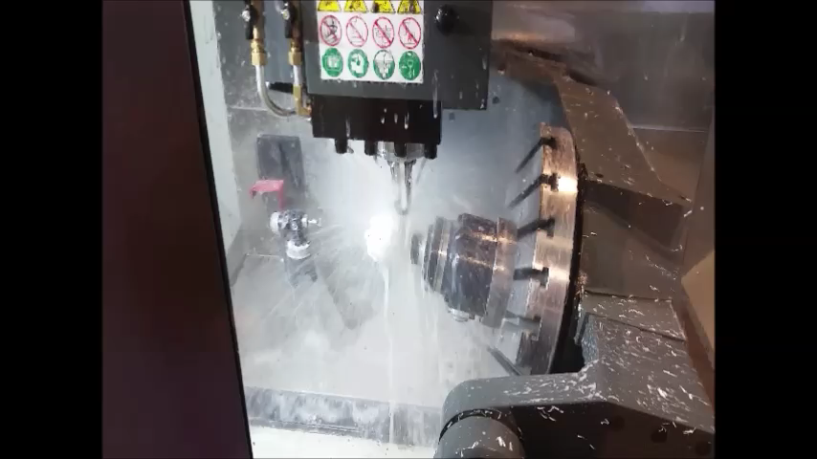
Flex Grip on 5 axis application

Slide 28
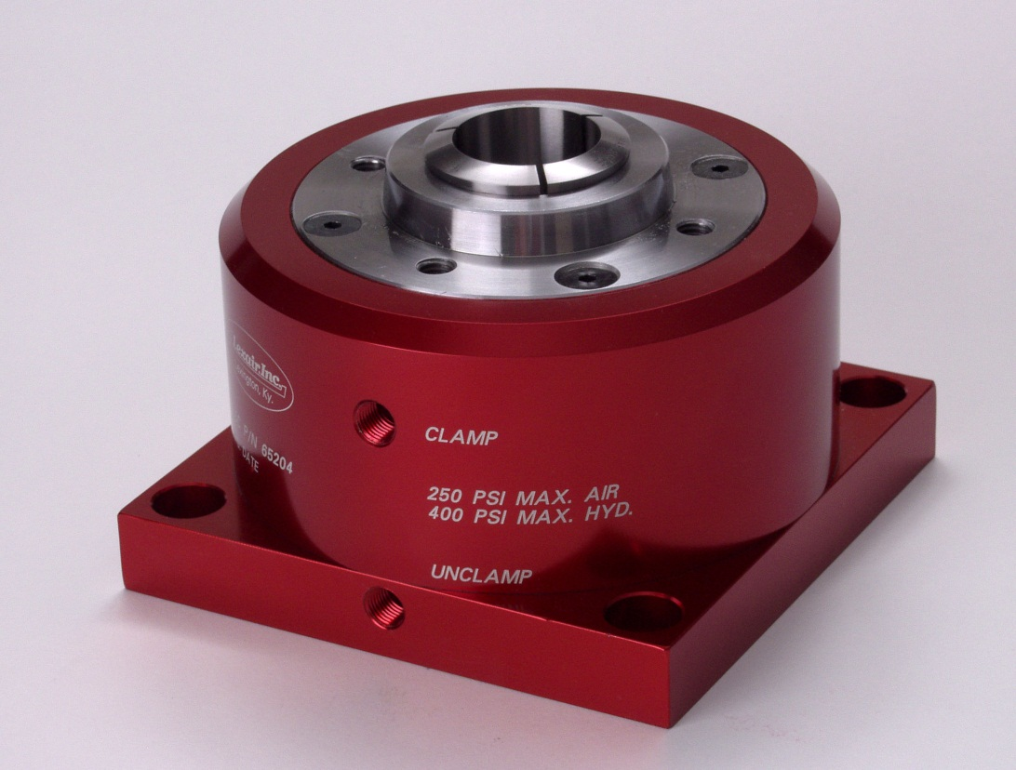
Pneumatic/Hydraulic Step Chuck Collet Closers
16C Details
Double acting, pull-back operation
Aircraft aluminum body with hardened steel bushings for long, trouble free life
A2-5 spindle nose accepts 16C collets to 1-5/8” or 16C step chucks up to 6” in diameter plus expanding nose collets for I.D. holding of parts

Slide 29
Pneumatic/Hydraulic Step Chuck Collet Closers
16C Details
Double acting, pull-back operation
Aircraft aluminum body with hardened steel bushings for long, trouble free life
A2-5 spindle nose accepts 16C collets to 1-5/8” or 16C step chucks up to 6” in diameter plus expanding nose collets for I.D. holding of parts
Drawtube force generated is 22.5 times the inlet pressure applied
Pneumatic working pressures to 250 PSI, hydraulic pressures to 400 PSI
Supplied with a 16C collet wrench

Slide 30
Machine Tool Accessories
Applications and Industries Serviced by Our Collet Closers
Part holding for assembly applications
Part holding for machining or grinding applications
Part holding for inspection and test procedures
High force units can be used for crimping operations
Models available are excellent for tool room and production environments
Modular units are easily combined into fixtures - We can design and manufacture custom turnkey solutions to meet the demands of all your workholding requirements
Industries served include:
Electronics
Dental
Heavy Equipment
Automotive
Aerospace
Power and Hand Tools
Medical
Machine Tool
General Industrial

Slide 31
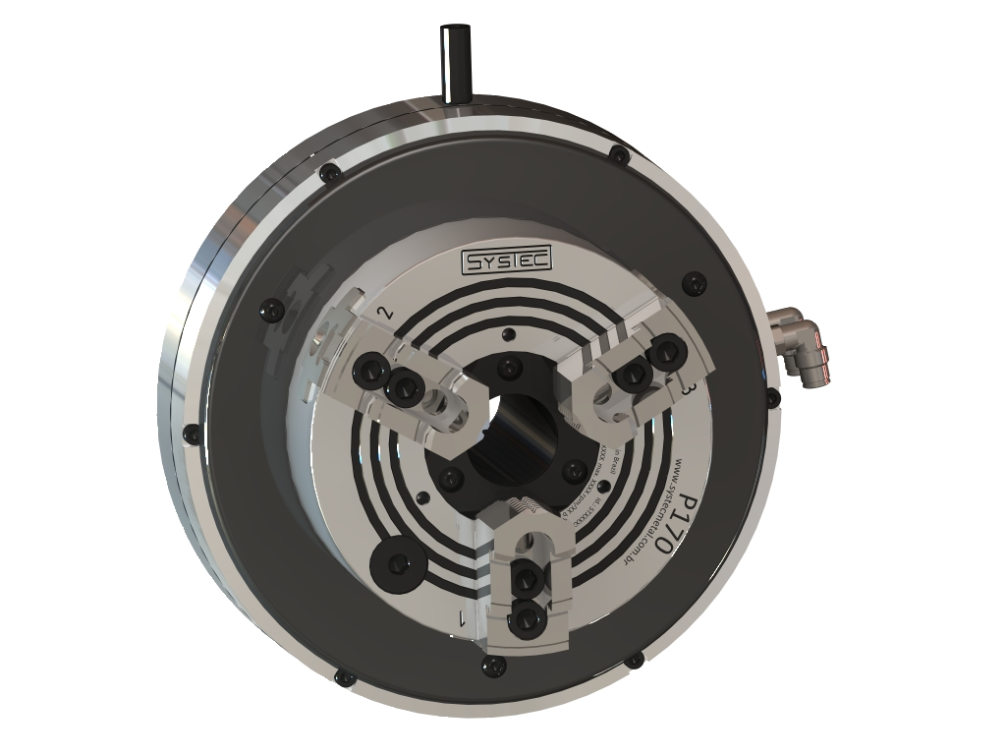

SYSTEC Self Contained Pneumatic Power Chucks
Greater rigidity and durability
No adjustment of Teflon elements is necessary
15 % Higher RPM capability than previous models
45 % More gripping force than previous models
Fast clamp and unclamp times
Environmentally friendly
Available in 2, 3, and 4 jaw versions
All sizes available in inch or metric serrations
Bodies are hardened to 62 Hrc and precision ground
Internal safety valves prevent loss of air pressure and gripping force
Five sizes are available up to 12” diameter to meet your application requirements

Slide 32
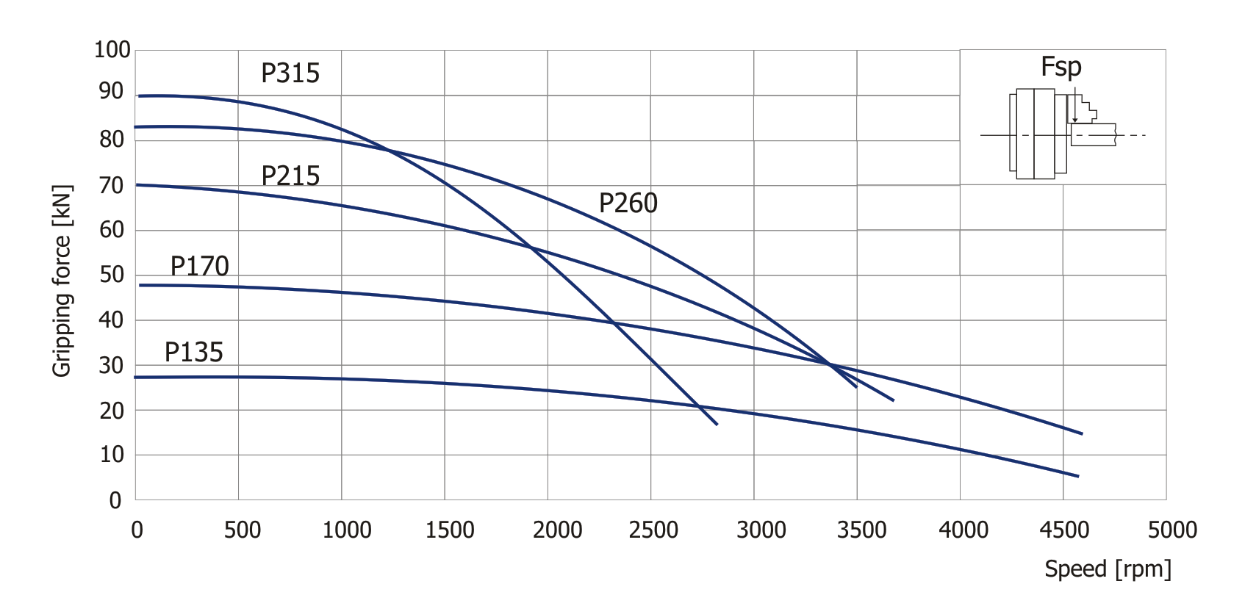
SYSTEC Self Contained Pneumatic Power Chucks
Gripping force while actuated at 87 PSI (6 bar)

Slide 33
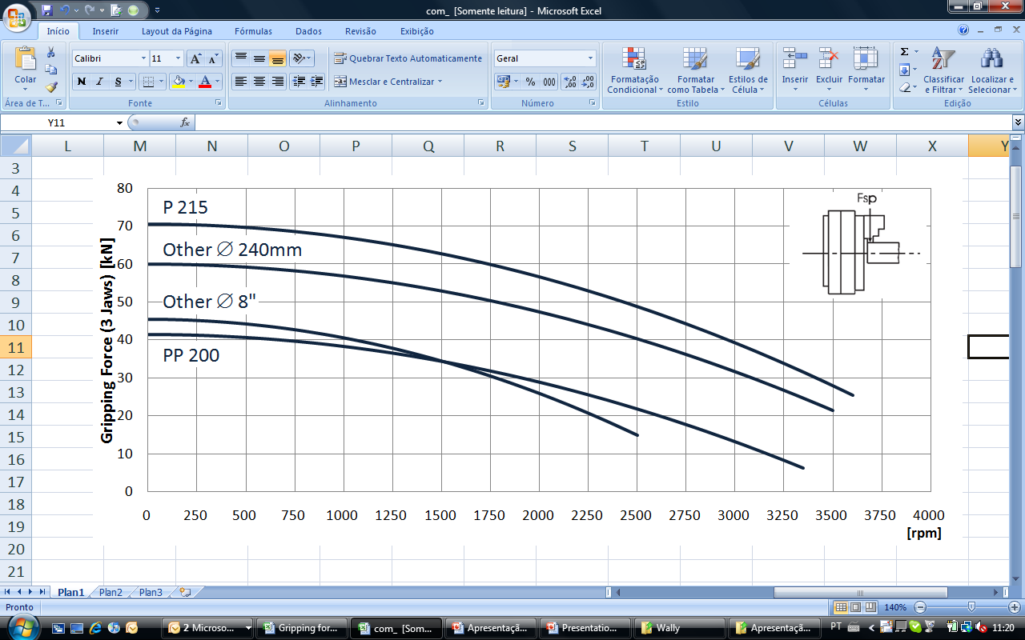
SYSTEC Self Contained Pneumatic Power Chucks
Gripping force comparison with other typical manufacturers

Slide 34
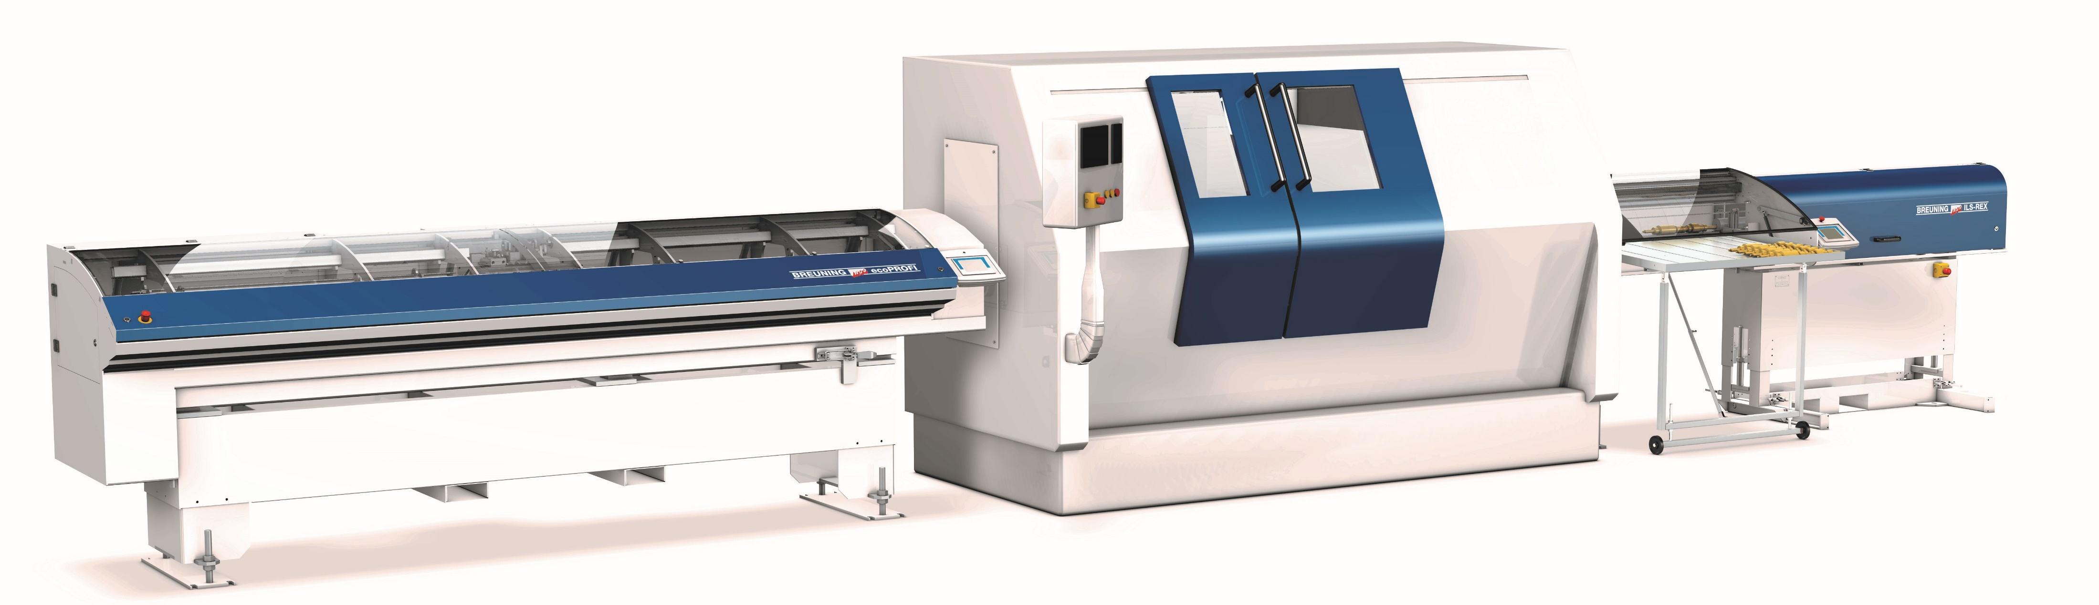
Breuning Irco
Europe's premier manufacturer of lathe automation
Large diameter and long bar loading/unloading automation systems
Work piece loading/unloading automation systems

Slide 35
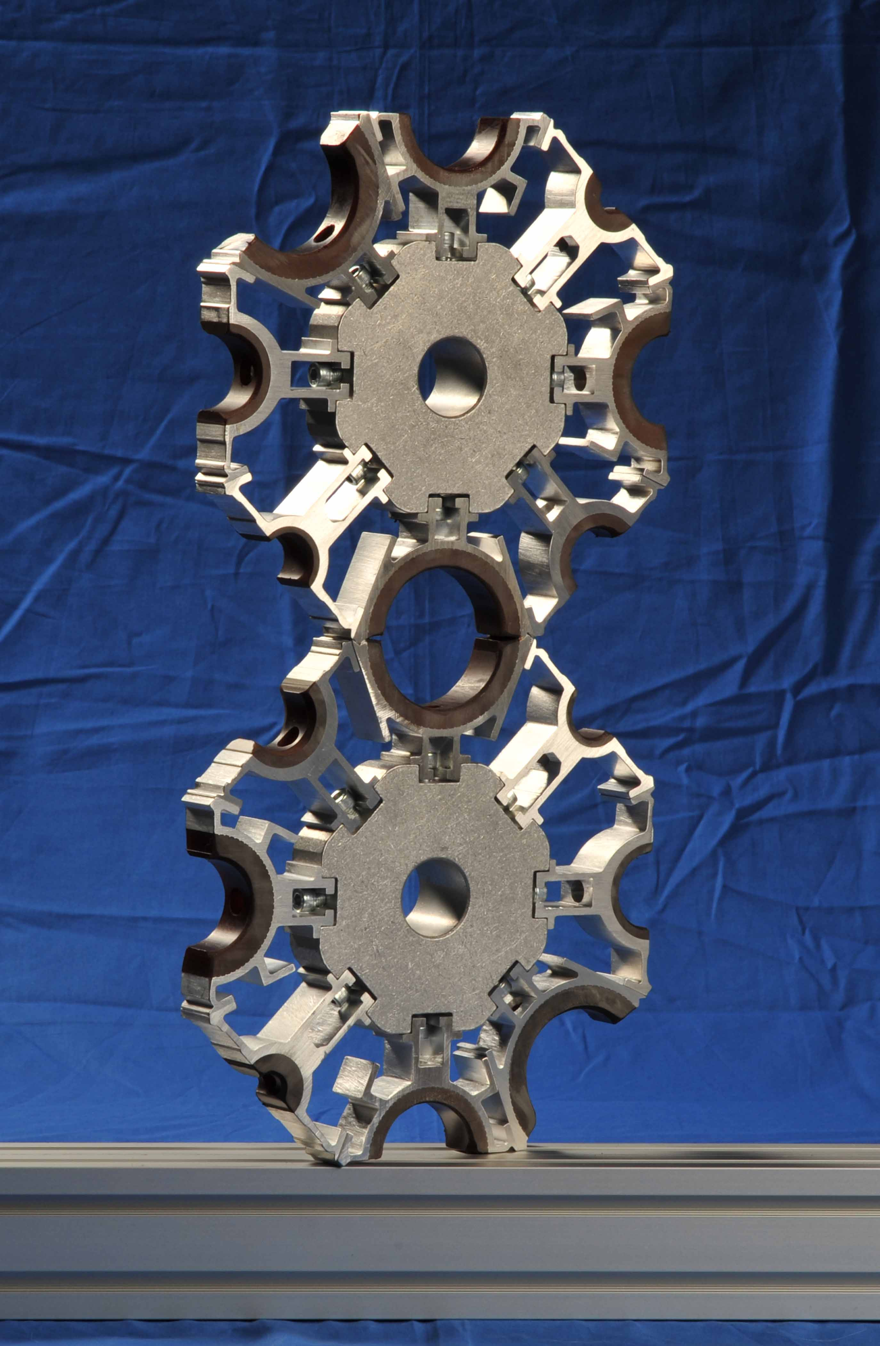
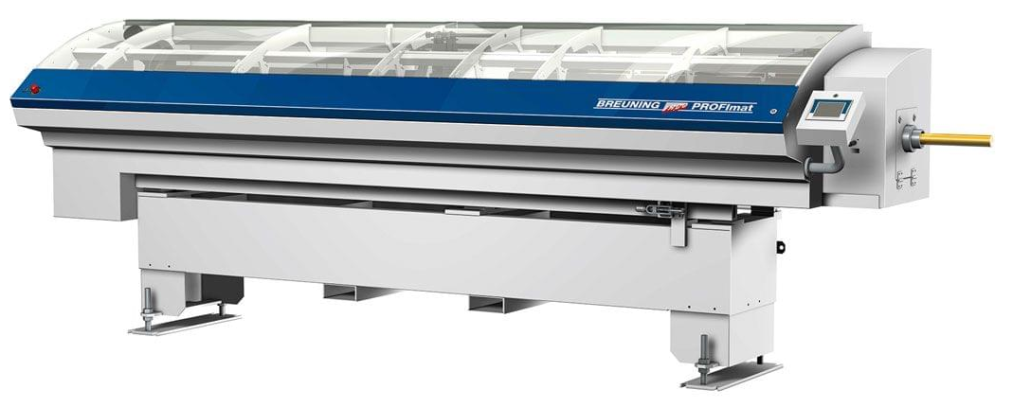
PROFImat
0.196” (5mm) to 5.125” (130mm) Diameter range
6 or 8 channels
Up to 6m standard, longer lengths upon request
Allows quick change between bar stock sizes automatically
Moves one meter back for spindle liner change
Decreases total change over time to 5 to 10 minutes
Suitable for short and long run applications

Slide 36


Slide 37
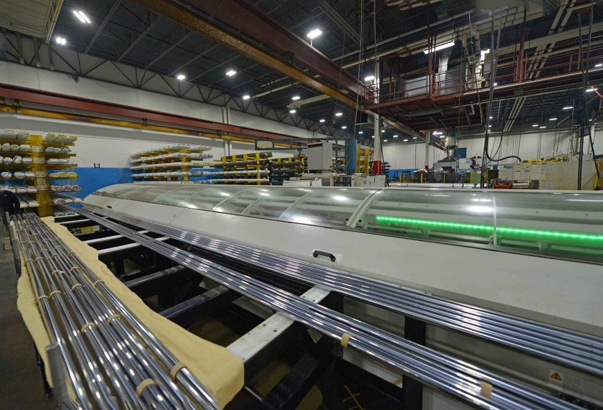
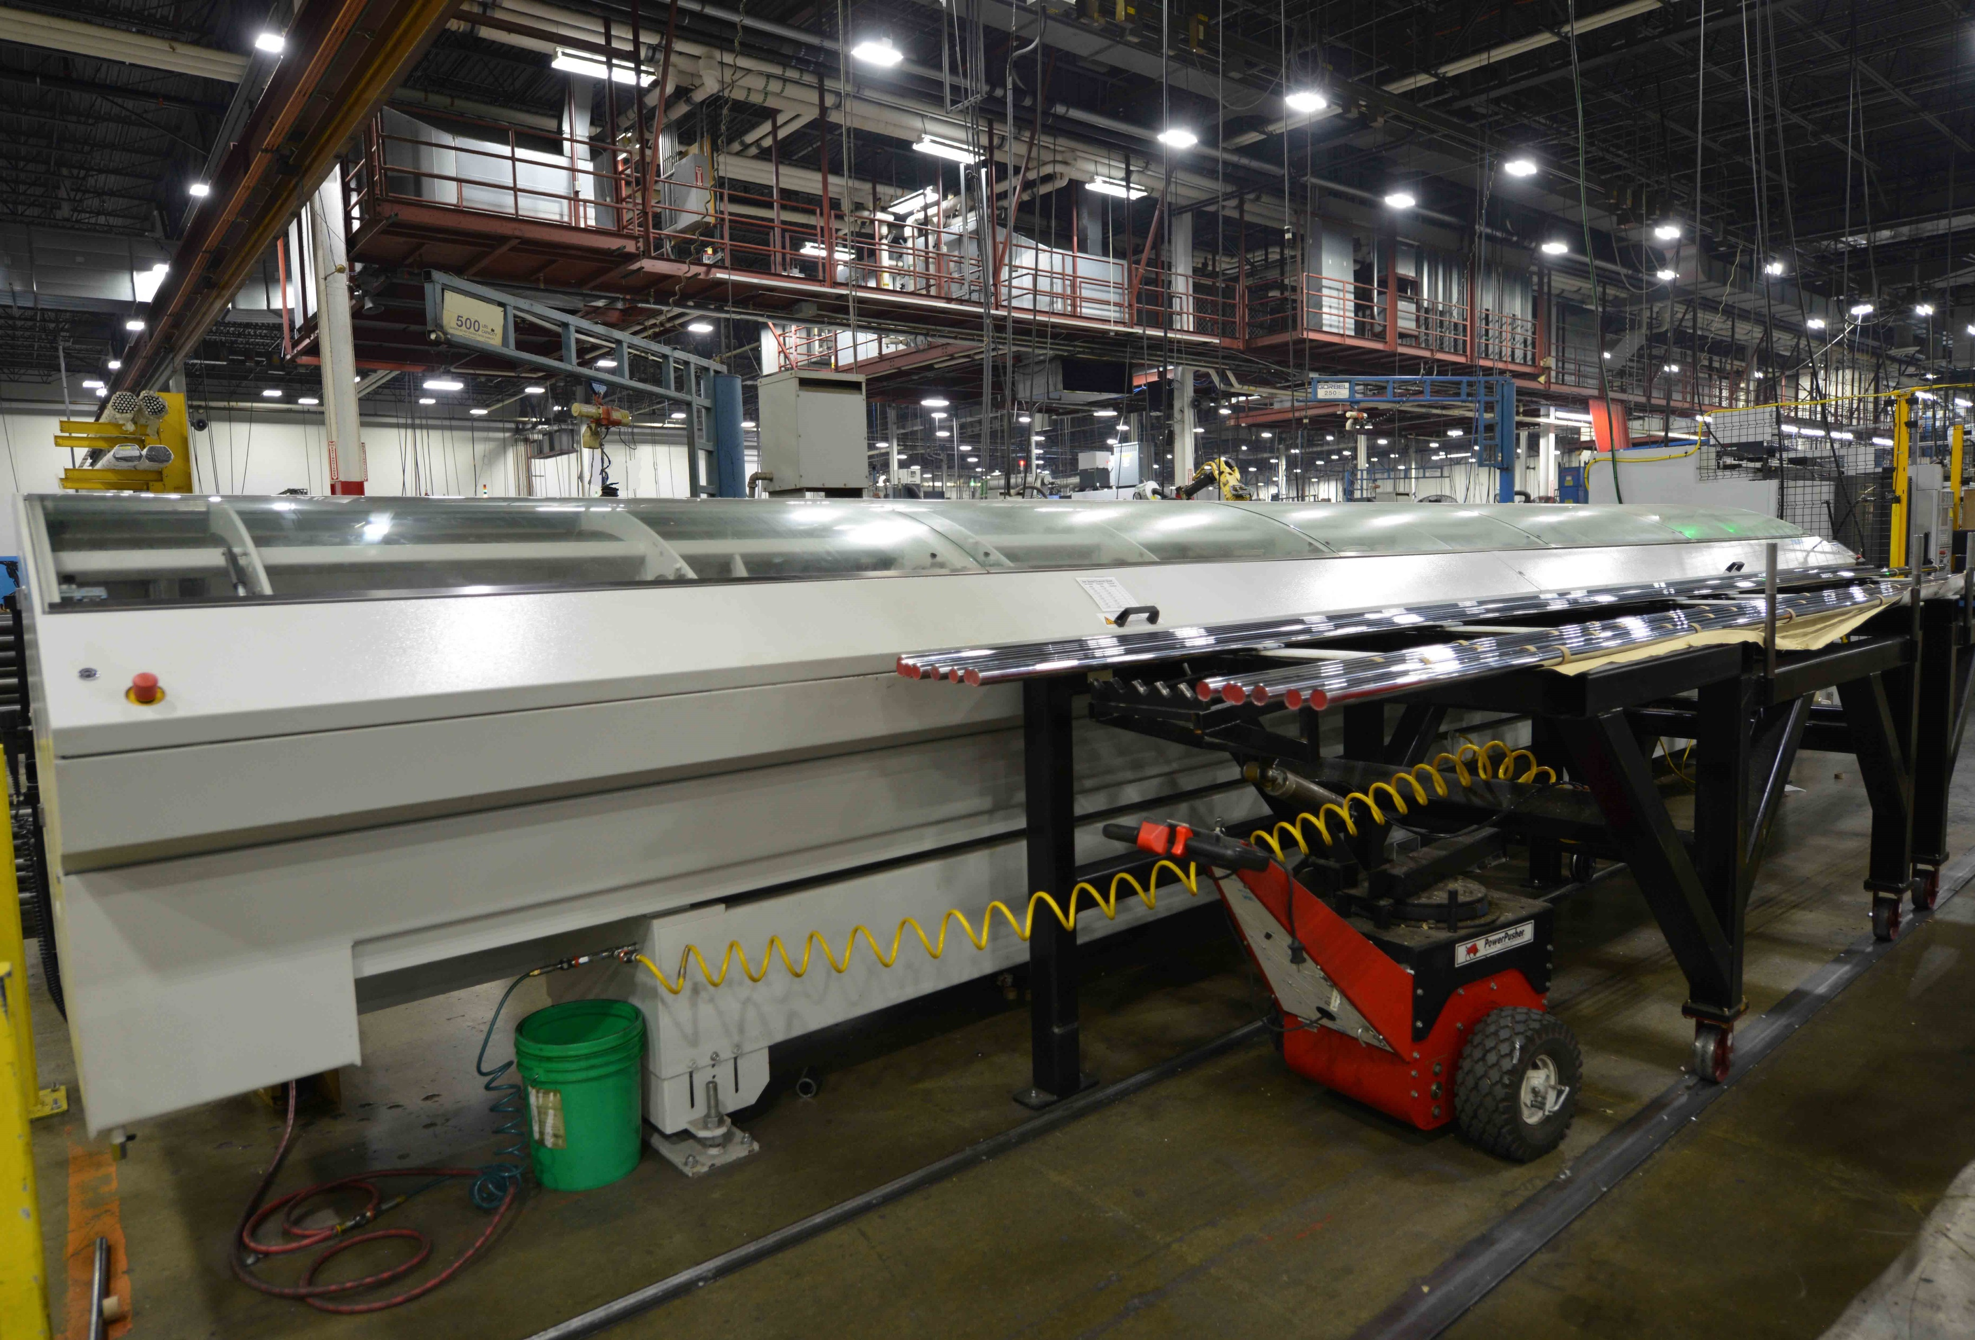
PROFImat Application
Notes:
Application feeding ground and polished bar stock 24ft long

Slide 38
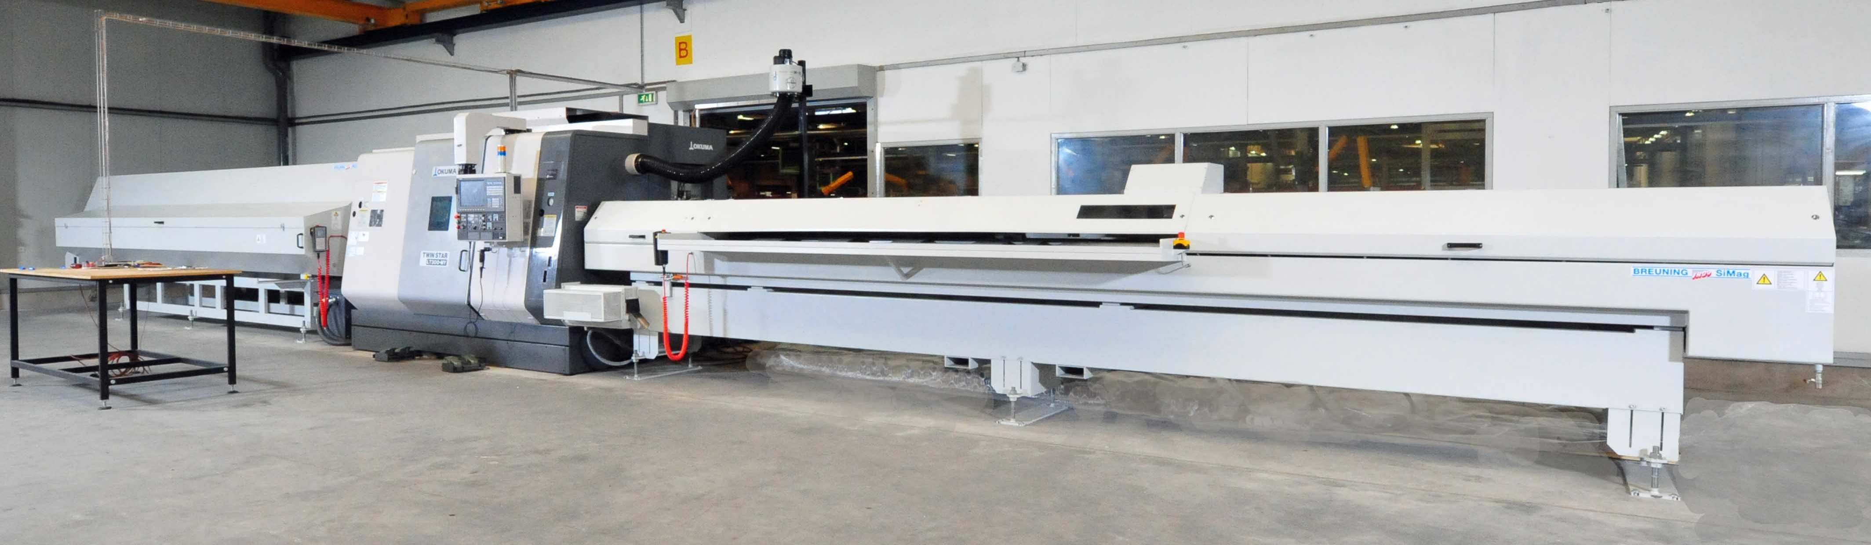
PROFImat Loader
SiMag ERV Unloader
Notes:
Application feeding ground and polished bar stock 24ft long

Slide 39
SiMag
0.196” (5mm) to 5.125” (130mm) diameter range
One channel included
  Can purchase additional channel sets
10 ft. (3000mm), 13 ft. (4000mm), or 20 ft. (6000mm)
  Other lengths upon request
Moves one meter back for spindle liner change
Ability to attach bundle loader to barfeed

Slide 40
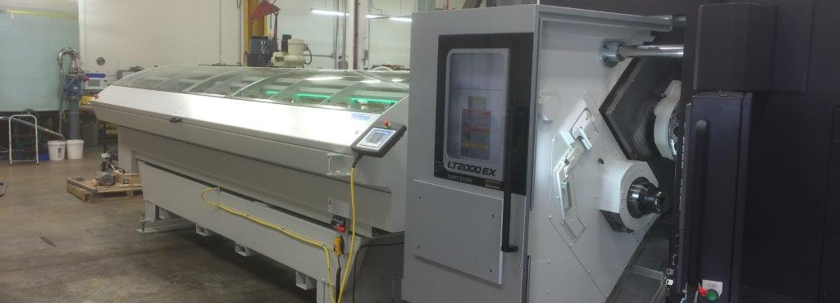
SiMag Application
Notes:
This application is a 20ft (6m) Simag loader and a (2m) Simag unloader.

Slide 41
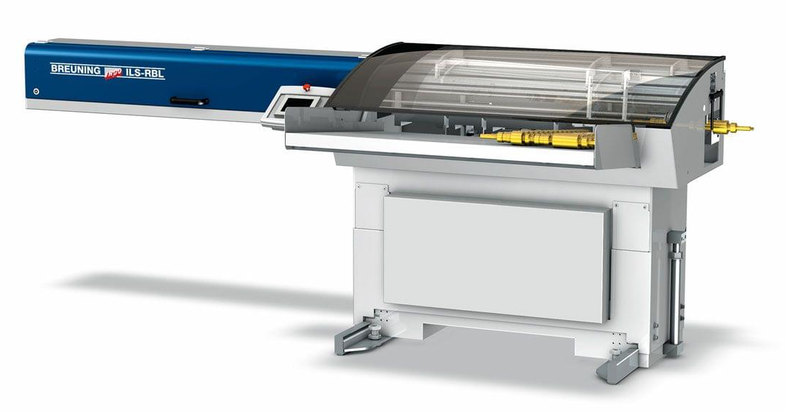
ILS-RBL / TBL
Loading for semi-finished parts
RBL – Tray table loading for parts
TBL – Index conveyor for loading delicate or non rolling parts
Max diameter to be loaded is 3.194” (80mm) or 4.724 (120mm)
Max length is 31” (800mm) or 47” (1200mm)
Collet loading for precision parts

Slide 42


Slide 43
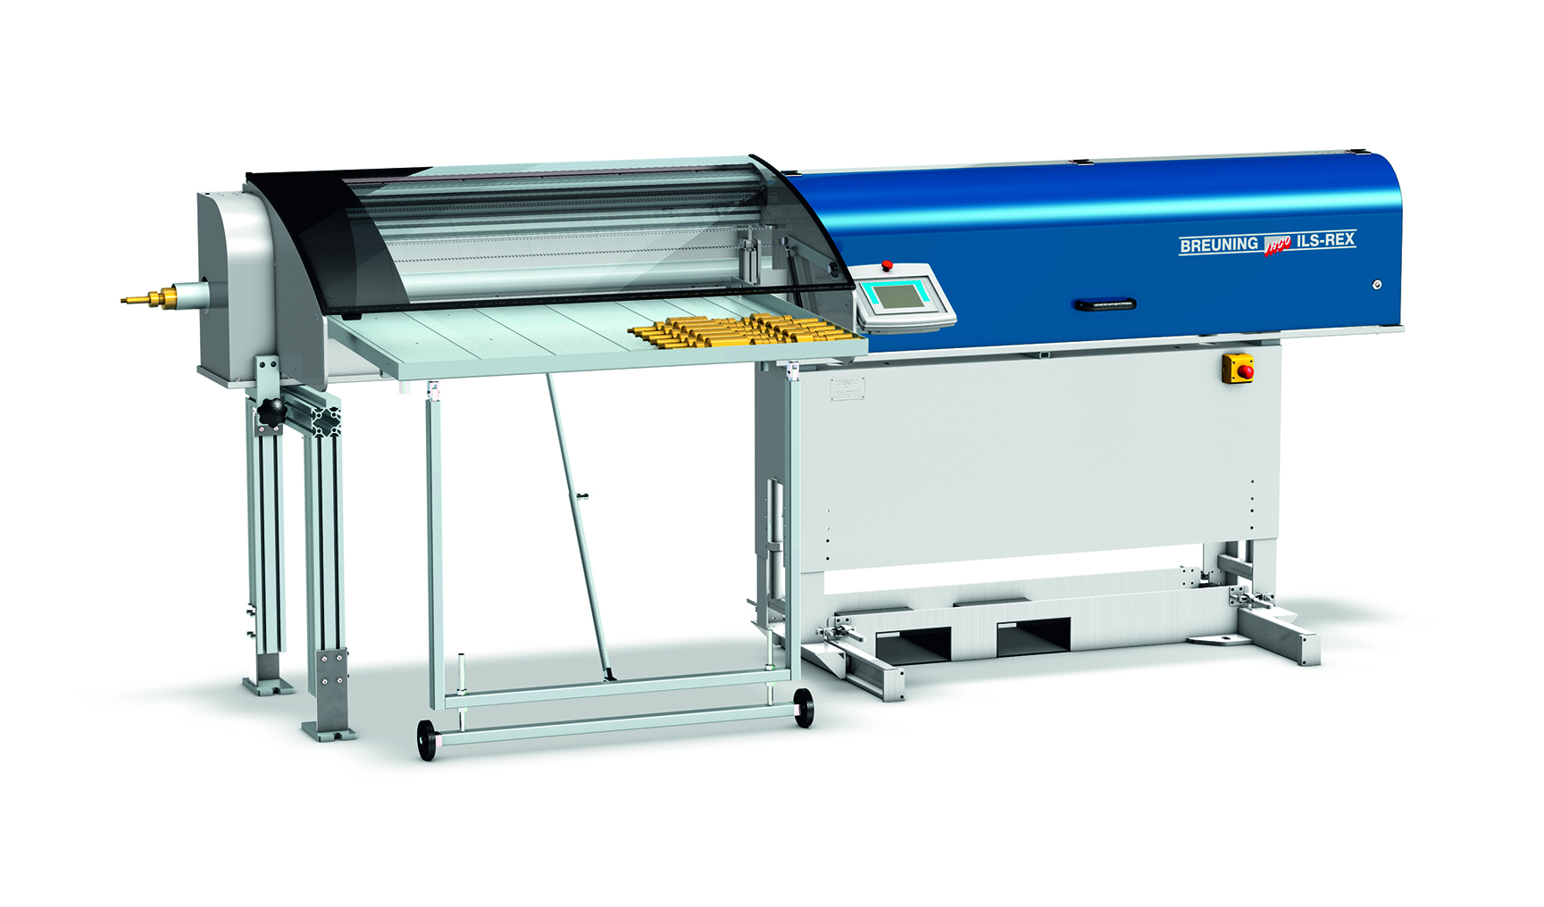
ILS-REX/TEX
Unloading for finished parts
REX – Tray table unloading for parts
TEX – Index conveyor for unloading delicate or non rolling parts
Max diameter to be unloaded is 3.194” (80mm) or 4.724 (120mm)
Max length is 31” (800mm) or 47” (1200mm)
ID and OD collet unloading for parts
For delicate parts a pusher tube with bushings protects part during unloading

Slide 44


